Slide 1
Welcome to

Slide 2
The DTS Garage door openers are imported by
DTS Security Products CC .
We continue to upgrade our products via our suppliers
to meet the consumers requirements.

Slide 3
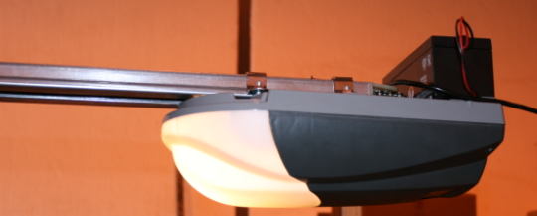
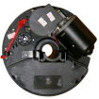
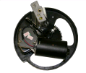
Garage door operator (GDO) Training
on
DTS600/800 – 12R – 16A

Slide 4
Checks prior to installation of GDO.
Ensure that the door is installed properly.
Make sure that when the garage door is moving, there are no friction points.
The tension springs must be set correctly.
For sectional and tip-up garage doors, the tension must be set so that the door in override position must stay were it is when left in the ¼, ½ and ¾ open position.
For roll-up garage doors, the tension must be set so that the door in the override position must start to roll down slowly by itself from just above the ½ open position. (Sometimes bottoms weights are required to be fitted at the bottom of the garage door).
This is to prevent coiling of the garage door when being closed.
The garage door must be properly balanced.
The garage door must be level.
Should be able to lowered and raise the garage door by hand with ease.
Make sure the garage door structure is solid and suitable to be motor driven.
Note: It is illegal to automate a Tip up garage door with counter weights on the side of the door.

Slide 5
Installation of GDO.
For Sectional Doors.
Fit the GDO as horizontal as possible.
Have a 220 volt power plug fitted as close as possible to where the motor head will be.
Make sure all fittings holding the GDO are secure.
Ensure that the chain tension on the GDO is correct.
For Tip-up Doors.
Fit the GDO with a tilt of approximately 15 degrees with the motor head being the lower part.
Have a 220 volt power plug fitted as close as possible to where the motor head will be.
Make sure all fittings holding the GDO are secure.
Ensure that the chain tension on the GDO is correct.
For Roll up Doors.
Make sure the GDO is as close as possible to the adaptor wheel.
Fit the GDO with the clamping plate parallel to the floor below the garage door shaft.
Have a 220 volt power plug fitted as close as possible to where the Control box will be.
Modify the adaptor wheel NOT THE GDO to fit into each other.

Slide 6
Features
DTS600/800 (800 to be used for Caravan and double garage doors).
24 volt DC motor designed.
Anti crush mechanism.
24 volt battery back up.
On board rolling code receiver. (RX).
Maximum of 20 remotes.
Auto close facility.
Manual release facility.
Easy to install.
Simple programming.
Can be used for Sectional, Tip up and Caravan Doors.
Safety Infra Red Beams can be connected.

Slide 7
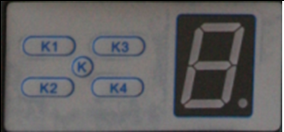
Programming.
Open and Close position.
Place door in approximately half open position.
Make sure that the traveler is engaged to the chain link.
Apply 220 volt power to the unit.
Keep all persons and property clear from the door.
Remove all external connections.
Press and hold SET (K1) button until LED displays the figure 1.
Press and hold UP (K3) button, the door must move to the open position.
Release the button when the door has reached the desired open position.
Can be fine set by using UP (K3) and DOWN (K4) buttons.
Press and release SET (K1) to store this position.
The LED will automatically change to the figure 2.
Press and hold DOWN (K4) button, the door must move to the close position.
Release the button when the door has reached the desired close position.
Can be fine set again by using UP (K3) and DOWN (K4) buttons.
Press and release SET (K1) to store this position.
The door will now automatically open and close to store the required load force.
Replace all external connections, if any.
The door is now set for normal operational use. (Note the change on the display)

Slide 8
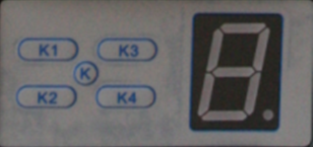
Manual adjustment on load force for special purposes.
Please note that this programming is generally not necessary.
Press and hold SET (K1) button until the LED displays the figure 3.
On releasing SET (K1) button the force setting will appear on the display, anything from 1 – 9.
Press UP (K3) to increase the load to a maximum figure of 9.
Or press DOWN (K4) to decrease the force to a minimum figure of 1.
Press and release SET (K1) to store your required setting.
Should the door meet and hinders it will stop and rebounds 15-20 cm.

Slide 9
Function modes.
Activate and De-activate the Infra Red Beams.
Make sure that your beams has been installed correctly before activating this function.
Press and hold DOWN (K4) button until the LED displays a -.
Press DOWN (K4) button once, the LED will display II, beams are now de-activated.
Press UP (K3) button once, the LED will display H, beams are now activated.
Please note: If beams are activated with no beams fitted, the GDO will open but will NOT close.
Press SET (K1) button to store your settings.

Slide 10
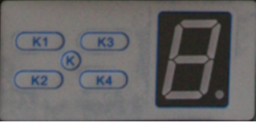
Setting of Auto close ON/OFF.
IMPORTANT: This function must not be activated if no beams are fitted.
Press and hold UP (K3) button until LED displays a -.
Press UP (K3) button, the auto close time will increase by 1 minute each time the UP (K3) button is pushed, the LED will display figures 1 to 9 with 9 being maximum.
Press DOWN (K4) button to de-crease the time by 1 minute on each push with the minimum being 1 minute.
If DOWN (K4) button is pushed until the figure 0 appears, the auto close is then de-activated.
Press SET (K1) to store your setting.

Slide 11
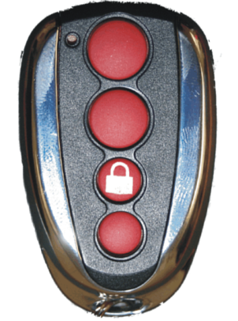
Setting of Holiday Lock-out ON/OFF.
Press and hold SET (K1) button until the LED displays figure 4.
On releasing the button the figure will change automatically to a 1.
or a 0.
Press UP (K3) button to display figure 1, holiday lock-out activated.
Press DOWN (K4) button to display figure 0, holiday lock-out de-activated.
Press SET (K1) button to store your required setting.
To over ride the holiday lock-out, press button no. 3 on the transmitter before the required button on the transmitter to open the garage door.
This can only be done with the transmitters supplied with the GDO from DTS Security Products.
Example button no.1

Slide 12
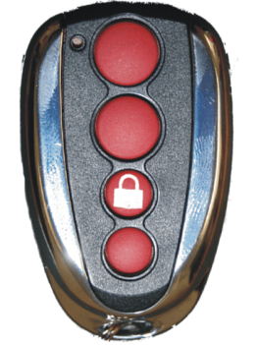
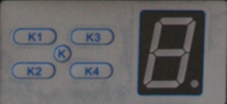
Programming of Transmitters. (Max.20)
Press and release CODE (K2) button, a red dot on the screen will light up.
Press the required button on the transmitter.
The Red dot will go off.
Press the same button on the transmitter again.
The Red dot will flicker a few times and stay off.
The LED display will then show a II.
Transmitter programmed successfully.
Repeat above to program a maximum of 20 transmitters.
Please note that button no. 3 cannot be programmed onto the on board receiver.
This button is used in conjunction with holiday lock-out.
Example button no.1

Slide 13
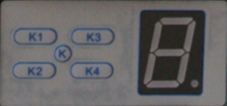
Master erase Receiver.
Press and hold CODE (K2) button, the Red dot will flash 14 times followed by the LED display flashing a letter C 4 times.
Release the button.
The LED display will then automatically show a II.
All transmitters are now deleted.

Slide 14
External connections.

Slide 15
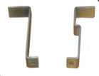
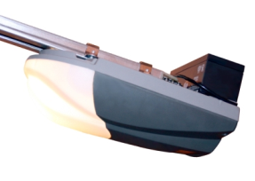
Connecting the battery back-up.
Fit the battery on top of the motor head, space provided.
Clamp battery down with the 2 provided brackets.
Connect the battery terminal wires to the provided wires on the motor head.
Allow time for batteries to charge fully.
The GDO is now ready to be used as a battery back-up system.

Slide 16
External receiver connections.
N/O Trigger
N/C Trigger
Receiver
CM Common
12 - 24v Neg.
12 - 24v Pos.

Slide 17
Infra red beam connections.
IR Beam TX
12-24v Pos
12-24v Neg
12-24v Pos
12-24v Neg
CM Com.
IR Beam RX
N/C Trig.
N/O Trig.
If sentry beams are being used, connect N/O Trig to PE.

Slide 18
Connecting of wall mount bracket.
Wall mount push button N/O
N/O
Common

Slide 19
Fault finding

Slide 20
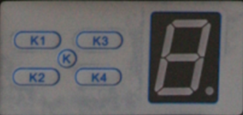
Disconnect external connections (Green connector block).
If the GDO now operates, reconnect the externals one at a time until the fault re-occurs.
That external unit is then faulty or incorrectly wired onto the GDO.
If a line in the middle of the LED display is on and nothing wants to operate.
The GDO was put into a none programmable mode.
Follow the normal open and close program procedure to over come this problem.
If the door closes but will not open, it is in holiday lock-out.
Follow the holiday lock-out procedure to unlock the GDO or utilize button number 3 on the DTS transmitter .
If the door opens but will not close, the beam function is enabled with no infra red beams fitted.
Follow the de-activate procedure to over come this problem, or bridge out the GND and PE connection on the green connector block.
If the door closes by itself, the auto close is activated.
Follow the auto close procedures to de-activate auto close.
Wires from infra red beam
Trigger wires, EG: Intercom

Slide 21
Important.
The DTS600/800 garage door operator described in this training session is designed for Sectional, Tip-up and Double garage doors.
Any other use is considered improper and WILL void the warranty.

Slide 22
End of DTS600/800 training.

Slide 23
Features
12R
24 volt DC motor designed.
Anti crush mechanism.
Optional 24 volt battery back up.
On board rolling code receiver. (RX).
Maximum of 20 remotes.
Auto close facility.
Manual release facility.
Easy to install.
Works with most roller doors.
Operates smooth and quietly.
Safety Infra Red Beams can be connected.

Slide 24
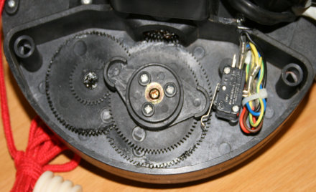
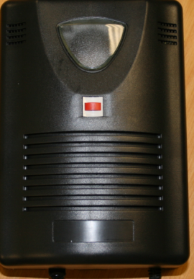
Programming.
No programming is required for the DTS 12R GDO.
Fit the motor to the garage door.
Check the motor and limit switch cord length and fit the Control panel box.
Connect the motor and limit switch cord to the PCB (Process control board).
Remove the side cover on the motor.
Close the door manually by hand.
Set the back (Bottom) cam to activate the back limit switch.
Open the door manually by hand.
Set the front (Top) cam to activate the front limit switch.
Set dipswitch number 1 to ON “D” disable position. (Auto close OFF).
Set dipswitch number 2 to the required position.
Standing inside the garage looking at the door.
Motor on left hand side of door, dipswitch 2 Down, towards L.
Motor on right hand side of door, dipswitch 2 Up, towards R.
Push the Red button on the control box to trigger the door.
Check and fine set the BACK and FRONT cam to the desired door open and close positions.
Motor on left.
Motor on right.

Slide 25
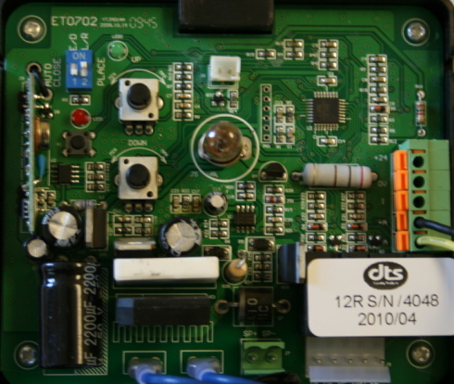
Load setting.
The load setting for open and close must be set manually by the load pots marked as UP for opening and DOWN for closing.
Turning the pots anti clock wise, decreases the load force.
Turning the pots clock wise, increases the load force.
The open and close load setting must be set individually.

Slide 26
Programming of Transmitters. (Max. 20)
Press and release the K1 learning button below the red LED.
The LED will go ON.
Press and release one of the four transmitter buttons.
The LED will go OFF.
Press and release the same button on the transmitter again.
The LED will flash fast 8 times.
That transmitter is now programmed.
Repeat the above steps for more transmitters.
If the LED on pressing and releasing of the K1 button flashes 4 double flashes, it is an indication that the Receiver is FULL.
EG: Button no. 1
K1 Learning button

Slide 27
Master erase Receiver.
Press and hold the K1 button, the led will flash 10 slow flashes.
All transmitters are now deleted from the on board receiver.
K1 Learning button
Notes:
.

Slide 28
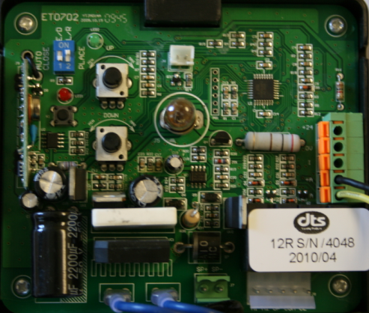
External Receiver Connection.
12-24V Pos.
12-24V Neg.
Common.
Receiver
N/O
N/C
DC power for the External receiver can also be obtained from the battery back-up terminals SP- and SP+
Please note – N/O from receiver MUST be connected to +A on the PCB.

Slide 29
Infra red beam connections.
N/C
N/O
Common.
IR Beam RX
12-24V Pos.
12-24V Neg.
IR Beam TX
12-24V Pos.
12-24V Neg.
DC power for the beams can also be obtained from the battery back-up terminals SP- and SP+
Note, the Common from the Beams goes to OV on the PCB.

Slide 30
Fault finding

Slide 31
Disconnect all external connections.
If the GDO now operates, reconnect the externals one at a time until the fault re-occurs.
That external unit is then faulty or incorrectly wired onto the GDO.
If the door coils around the shaft before coming down,
a) The spring tension is not set right.
b) The door might need some counter weights.
If the door stops by itself in the opening cycle, the open load setting might be set too low.
If the door stops and opens by itself in the closing cycle, the close load setting might be set too low.
In both the above situations, it could also be that the door is being obstructed in its guides.
If the door closes by itself, dipswitch number 1 is incorrectly selected.
If the door opens by itself, dipswitch number 1 & 2 is incorrectly selected.

Slide 32
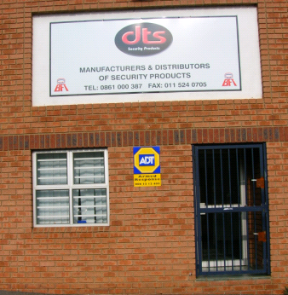
End of training presentation
Thank you for attending.

