Slide 1

Welcome to

Slide 2
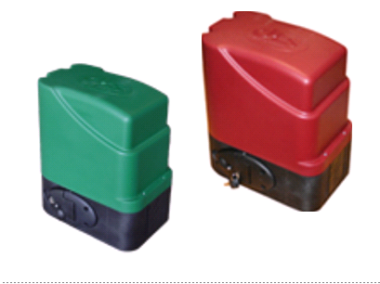
Gate motor training
on DTS
EXPERT 500 & ELITE 600

Slide 3
The DTS gate motors are Designed and Manufactured locally by
DTS Security Products CC for South African conditions.
We continue to upgrade our products to meet the
consumers requirements

Slide 4
DTS
Expert 500 & Elite 600
Expert 500
500 kg. (Gate weight)
12 volt motor.
Elite 600
600 kg. (Gate weight)
12 volt motor.
More important than the gate weight, is the gate pulling force.
Expert 500 = 12.5kg continuous pulling force.
Elite 600 = 15kg continuous pulling force.

Slide 5
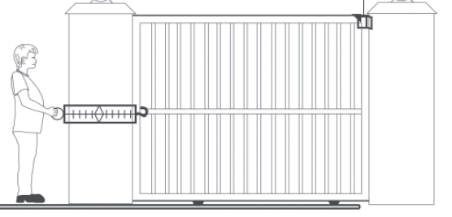
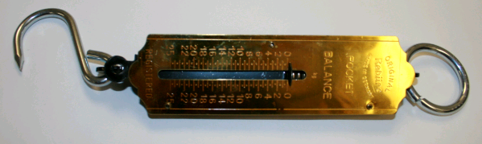
Gate pulling force.
Pull gate in both directions from, completely open to completely closed
and again from completely closed to completely open.
Reason, gate could be installed on a incline. Otherwise.
Scale should not pull more than 12.5 kg with the Expert 500
and 15 kg with the Elite 600
Using a Fish Scale

Slide 6
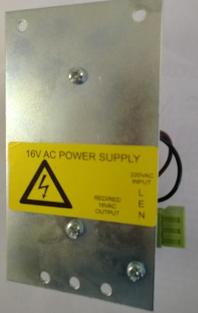
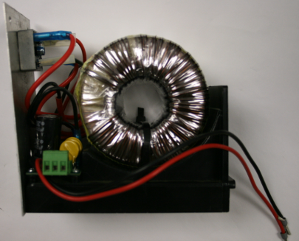
Features.
DTS Elite 600 Gate motor.
High access transformer for MULTIPLE users. (True battery back up).
DTS Expert 500 Gate motor.
16V AC Low voltage transformer for DOMESTIC use. (Battery operated).
Gate speed running at 18m per minute.
Pulling force up to 20Kg
Available in Magnetic and Spring limits.
Easy to program.
Switch mode (high efficiency) control card.
Dual on board rolling code Receiver (RX).
1 for Full opening, 1 for Pedestrian opening.
Maximum of 31 remotes as a joint combination between Full and Pedestrian open.
Pedestrian facility.
Auto close facility.
Courtesy light output facility or, Anti hijack/Alarm facility.
Dynamic slow down facility in closing and opening cycle.
Load sensitivity adjustment facility.
Gate speed running at 18m adjustable to 28m per minute
Pulling force up to 25Kg.
What does this mean?
When the following happens, the gate motor will set off an alarm.
1) When the gate is moved from its close limit without a valid trigger.
2) When the gate stands open for longer than 3 minutes.
3) When the beams are blocked and the motor receives a trigger to open.
4) When the gate cannot move from the closed position on a trigger due to
an obstruction. (Gate tied up to the pole)

Slide 7
Recommended installation of gate track.
Motor base plate with fixing screw.
Dia. 16 mm Round bar.
50 x 50 Angle Iron.
Trench in driveway.
Concrete.
Stabilizing spikes

Slide 8
Fitting of gate stoppers as a
safety precaution.

Slide 9
Open end stopper.
End stopper
Height should be just above the center of the gate wheel.
Complete track

Slide 10
Top view.
Close stopper and guide.
Pole
Gate
Gate guides

Slide 11
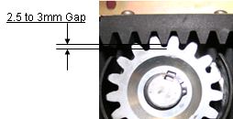
Fitting the rack with a gap between rack and pinion.

Slide 12
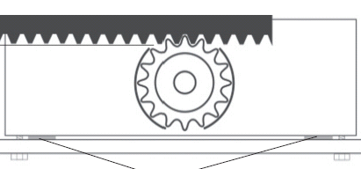
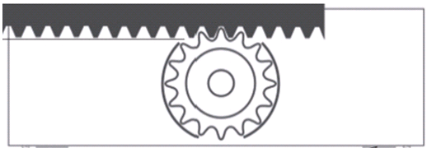
How do we get the gap?
Spacers
Place 4 x 2.5mm spacers between the motor and base plate.
( 2.5mm welding rods can be used for spacers ).
Hand tighten the fastening screws on the motor.
Now fit your rack.
Remove the spacers once the rack is fitted.
You should now have a even gap of 2.5 – 3mm between rack and pinion.

Slide 13
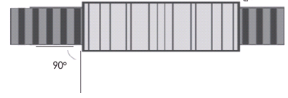
Final positioning required before tightening the motor mounting screws.
1) Ensure that the motor is parallel with the rack.
2) Ensure that the motor is free from the rack throughout the travel distance of the gate.
3) Fastening of the mounting screws can now commence.
Must be equal
Motor

Slide 14
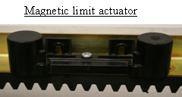
Fit the magnetic or spring limit actuators onto the rack.
Please take note of the correct positioning of the actuator on the rack.
(The cylindrical shape must stand upright).
Close actuator – Close the gate with approximately 10 - 20mm gap between gate and stopper.
Now move the actuator until the close led lights up. Fasten the actuator with provided screw.
Open actuator - Open the gate with approximately 10 - 20mm gap between gate and stopper.
Now move the actuator until the open led lights up. Fasten the actuator with provided screw.
Notes:
Open actuator - Open the gate with approximately 10 - 20mm gap between gate and stopper.
Now move the actuator until the open led lights up. Fasten the actuator with provided screw.

Slide 15
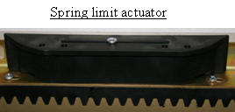
Please take note of the correct positioning of the actuator on the rack.
(The lip on the actuator must be on top).
Close actuator – Close the gate with approximately 10 - 20mm gap between gate and stopper.
Now move the actuator until the close led lights up. Fasten the actuator with provided screw.
Open actuator - Open the gate with approximately 10 - 20mm gap between gate and stopper.
Now move the actuator until the open led lights up. Fasten the actuator with provided screw.

Slide 16
Important !!!!
Never connect 220 Volt
directly to the PCB.

Slide 17
Programming and functions on DTS Expert 500 with PCB SL100

Slide 18
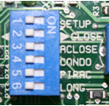

Dipswitch Selection.
Gate
Select dipswitch number 2 to correct closing direction.
OFF – Gate closing to left.
ON – Gate closing to right.
Select dipswitch number 6 to - OFF (400 mm) for heavy moving gates.
and - ON (800 mm) for smooth moving gates.
Gate motor
All other dipswitches should be in the OFF position for new installations.

Slide 19
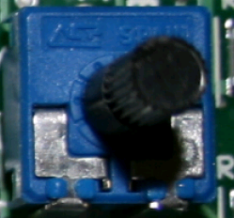
Adjusting the load pot.
The load is adjusted by turning the load pot completely anti clock wise (left) for minimum load,
and completely clock wise (right) for maximum load.
The PCB will give 1 - 5 beeps on the first trigger indicating in which position the load pot is set on, 1 being minimum to 5 being maximum.
5 Beeps
4 Beeps
3 Beeps
2 Beeps
1 Beep
Minimum
Maximum

Slide 20

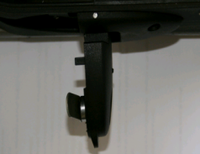
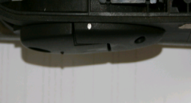

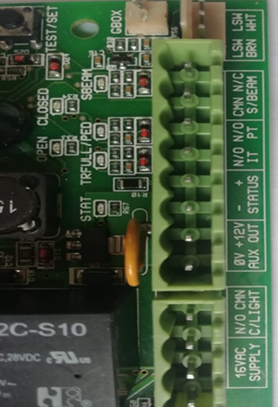

Now do the following steps.
Set load pot on MAXIMUM. (Completely clockwise).
Open the override lever on the motor.
Open the gate approximately 1 meter.
Close the override lever on the motor.
Pull the gate in any direction to ensure that the gearbox is engaged.
Ensure that the override double green wire is connected to the PCB.
Ensure that the limit, double white and brown wires are connected.
Make sure that AC and DC power is CONNECTED to the PCB.
(AC power is required to reset the PCB to accept battery power).
Remove all external connections (Beams, intercom, receiver ect.).

Slide 21
Programming (Calibrating) the run time of the gate can now commence.
Expert 500 PCB SL100

Slide 22
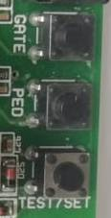
Push and release the TEST/SET button.

Slide 23
The following steps should now happen.
The gate must close in crawl speed until it reaches the close limit.
Will then open, still in crawl speed until it reaches the open limit.
Will then close at normal speed.
Change to crawl speed towards the end until it reaches the close limit.
PCB will give 2 beeps as indication to confirm, program completed.
External connections (Beams, intercom, receiver ect) can now be connected.
Motor is now ready for use.
----------------------------------------------------------------------------------------------
The above programming will always automatically happen when a total power failure occurred (AC and DC power) and a transmitter or any trigger is received after the power was restored.
No dipswitch changes are required when this happens.

Slide 24
The open and close actuators on the rack must, after programming, be re-adjusted to the correct gap between:
1) The gate and the closing stop pole.
(Approximately 10 -15 mm)
2) The gate and the end stopper.
(Approximately 10 -15 mm)
3) The above gaps must be there after the gate
has stopped on the open or closed limit).
Note: The gate must never bump the close or
open end stoppers.
Ensure that no other objects are making contact
that can create an overload.

Slide 25
Programming of the transmitters on Expert 500 PCB SL100
Max. of 31 transmitters (Slots) in total.
Full open trigger
GATE
Pedestrian trigger
PED
Program transmitters only after the gate run time (Calibrating)
program cycle has been completed.

Slide 26
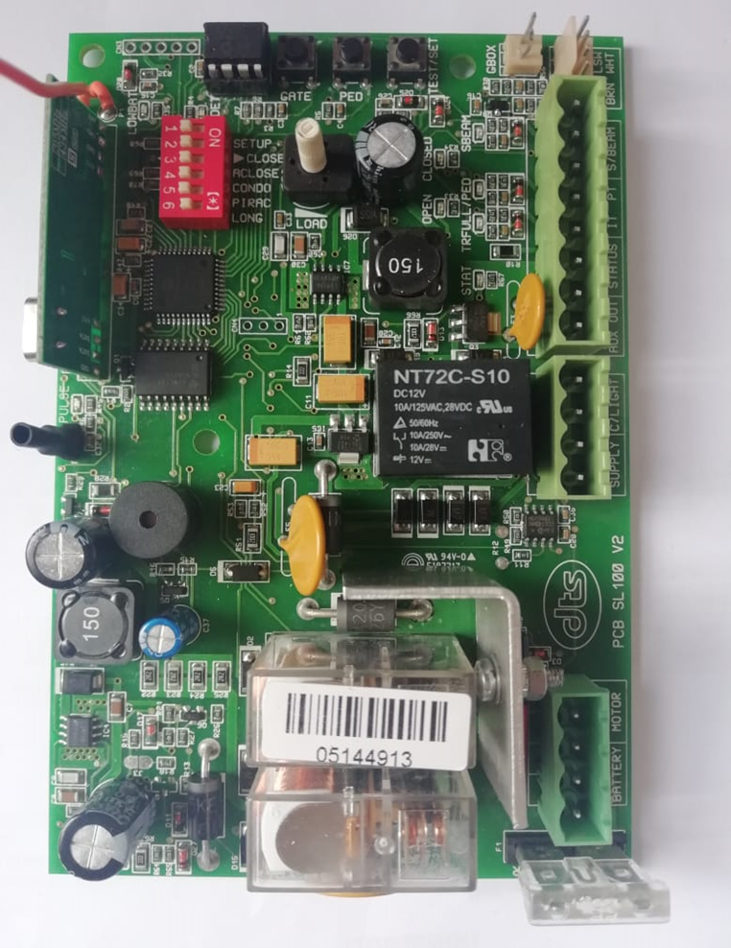
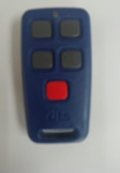
ON BOARD RECEIVER PROGRAMMING
(The override lever must be closed for programming transmitters).
PROGRAMMING A TRANSMITTER (TX) FOR PEDESTRIAN OPEN OPERATION
PROGRAMMING A TRANSMITTER (TX) FOR FULL OPEN OPERATION
Press and release the PED button, the RX light will go on.
Press and release the remote button you want to learn two times about an arms length away from the PCB
The PCB will beep two times to confirm successful programming.
Press and release the GATE button, the RX light will go on.
Press and release the remote button you want to learn two times about an arms length away from the PCB
The PCB will beep two times to confirm successful programming.
Important!!
Only DTS TX5 remotes will
Program on DTS Gate Motors
sold from October 2018

Slide 27
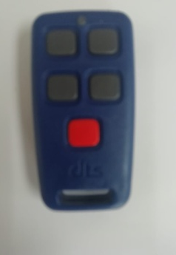
To ERASE single or all transmitters on the on board Receiver
EG: Button no.1
Individual Transmitter erase.
Push and hold the GATE button for 5 seconds.
The PCB will give 1 Beep.
Release the GATE button once the PCB has beeped.
Now push & release the Button on the Transmitter to be erased.
The PCB will give 2 beeps as confirmation, transmitter code deleted.
The above, utilizing GATE, also applies for a remote programmed on PED
Master erase Receiver.
Push and hold the GATE button, after 5 seconds the PCB will give 1, 1 second beep, Keep holding for approximately 5-10 seconds until the PCB give 1 x 2 second beep.
Release GATE button.
All transmitters, GATE & PED on the receiver will now be erased.

Slide 28
Further programming
To adjust auto close time(default 10 sec)
To adjust pedestrian open limit and auto close time (default 1m & 10 sec)

Slide 29
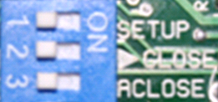

Auto close
Auto close (Factory default 10 seconds)
Switch dipswitch 1 and 3 ON.
All other dipswitches must be in the OFF position.
(Except no. 2, if gate closes to the right, then no. 2 stays on).
Press & hold TEST/SET button.
PCB will Beep (1 Beep = 1 Sec)
Maximum 180 seconds (3 minutes)
Release TEST/SET button at required auto close time.
Switch Dipswitch 1 and 3 OFF.
Switch Dipswitch 3 back ON to activate the auto close.

Slide 30
Auto close function.
When auto close is selected (Dipswitch number 3 ON), the gate will not remain open in any open position.
When triggered while opening, it will stop and wait for auto close time and close.
When triggered while closing, it will stop and open immediately.
In the full open position, it will wait for the auto close time and close.
Beams must be fitted with this function selected.
- This is to avoid an accident from occurring.

Slide 31
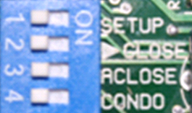
Pedestrian opening
Pedestrian Opening (Factory default 1 meter / 10 seconds auto close)
Gate must be in close position.
Switch Dipswitch 1 and 4 ON.
All other dipswitches must be in the OFF position.
(Except no. 2, if gate closes to the right, then no. 2 stays on).
Press & Release TEST/SET Button.
Gate will open.
Press & release TEST/SET button to stop gate at required pedestrian opening distance.
Press & Hold TEST/SET button to program auto close time required.
Control card will Beep (1 Beep = 1 Sec)
Maximum 120 seconds. (2 minutes).
Release TEST/SET button at required pedestrian auto close time.
Switch Dipswitch 1 and 4 OFF.
Gate will close and give 2 beeps to confirm, program complete.
Do not switch dipswitch number 4 back ON.

Slide 32
Pedestrian function.
When pedestrian function is triggered, the gate will open to the factory default of 1 meter or to the re-programmed distance.
The gate will always auto close after the factory default time of 10 seconds or the re-programmed time.
The PCB will always give 2 beeps before opening and again 2 beeps before auto closing.
The auto close on the pedestrian facility cannot be overridden as is the case with normal full opening.
If a trigger is received in the closing cycle via transmitter for full opening or push button (IT & Common) connection, the gate will stop and open to the full open position. (IT = Intercom Trigger, CMN = Common).
If the gate is stopped via beams in the closing cycle, the gate will stop and re-open back to pedestrian position as a safety precaution.

Slide 33
Further functions.

Slide 34
Standard function.
No dipswitch selection must be ON other than perhaps 2 & 6 where necessary.
The gate can then be stopped in any position and will only move when a trigger is received.
The gate will not auto close.

Slide 35
Party mode function.
This is a function whereby auto close can by overridden.
This can only be done in the fully open position.
Wait for the gate to stop on the open limit, then push and hold the full open trigger transmitter or IT & CMN connection button for approximately 6 seconds until the PCB gives a acknowledgement (1 single 1.5 second beep).
The gate will remain open until another trigger is received.
Once triggered again, auto close is back to normal.

Slide 36
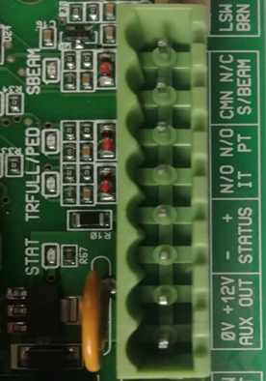
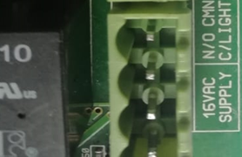

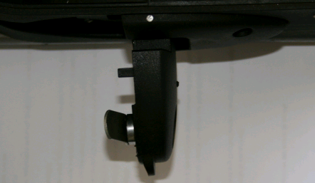
Tamper Alarm.
Latch Alarm (Dipswitch 1 & 6)
Pulse Alarm (Dipswitch 1 & 5)
To activate pulse alarm
Remove all power.
AC and
DC
Switch dipswitch 1 & 5 to ON position.
Rest of the dipswitches to OFF position.
(Ignoring dipswitch number 2).
Open the override lever.
Apply AC power.
The PCB will start to beep continuously.
Switch dipswitch 1 & 5 to OFF position.
Close the override lever.
Now carry on as normal.
To activate latch alarm
Remove all power.
AC. And
DC.
Switch dipswitch 1 & 6 to ON position.
Rest of the dipswitches to OFF position.
(Ignoring dipswitch number 2).
Open the override lever.
Apply AC power.
The PCB will start to beep continuously.
Switch dipswitch 1 & 6 to OFF position.
Close the override lever.
Now carry on as normal.
Wiring, Latch (Siren)
Wiring, Pulse (Alarm)
Alarm Panel
Com.
Zone
Connect required
E.O.L. resistor.
Com.
N/C
Neg.
Receiver
Pos.
Transmitter
Bridge push
button contacts
Battery
Pos.
Neg.
Pos.
Neg.
Remove the battery.

Slide 37
Holiday lock out function.
With the gate in the close position.
Press and hold the pedestrian trigger transmitter button or PT & CMN connection on the PCB for approximately 13 seconds until the PCB gives a acknowledgement of 1 long 3 second beep.
If a normal trigger is now received, the board will give 4 quick 100ms beeps to indicate PCB is in holiday lock-out.
To remove holiday lock out, repeat step 2 above. The board will give 5 x 1 second beeps to acknowledge, lock out cleared from PCB.
This function is not applicable if condominium mode (dipswitch number 4) has been selected.
This function must be programmed to enable the function.
To program holiday lock out, follow the alarm function procedure but utilizing dipswitch 1, 5&6.

Slide 38

Condominium function.
This function is mainly for multiple users. (Complexes)
Switch dipswitch number 4 ON
With this function selected, the board will not respond to any trigger while the gate is opening or in the open position.
If the gate is closing, it will accept the first trigger, stop and open.
The auto close is automatically activated by this function, even if dipswitch number 3 is not selected.
Auto close can only be overridden by giving the PCB a continuous trigger via transmitter or timer connected to IT & CMN.
The gate will automatically close as soon as the continuous trigger is released.
Beams must be fitted with this function selected.

Slide 39

PIRAC function.
PIRAC = Passive Infra Red Access Control.
Switch dipswitch number 5 ON
This function works in conjunction with installed IR beams.
When the gate is opening and the beam is activated, the gate will continue to open but will stop and close immediately when the beam is cleared. (Reason – Truck and trailer).
When the gate is opening and the IR beam is activated, the gate will stop immediately and close immediately when the IR beam is clear.
Be aware of this factor should a trailer be in tow!!
This will happen even if auto close has not been selected.
When the gate is closing and the IR beam is activated, the gate will stop and open immediately.
The auto close is automatically activated by this function, even if dipswitch number 3 is not selected.

Slide 40
Overload/collision function.
When the gate hits an obstruction in the closing cycle, it will stop, open and give 20 beeps. On the 3rd consecutive collision the gate will open, give 20 beeps, and will not close again. The PCB will then go into a 3 minute overload lockout.
When the gate hits an obstruction in the opening cycle, it will stop, give 20 beeps. Will close when triggered or auto close activates. On the 3rd consecutive collision, the gate will not close and the PCB will also go into a 3 minute overload lockout.
When triggered while in overload lockout, the PCB will give 1 single 3 second beep as indication that the motor is in overload lockout.
The 3 minute overload lockout can be manually released by opening and closing the override lever on the gearbox or by removing and replacing the double green wire on the PCB.
When closing the override door or reconnecting the double green wire, the gate will always after a trigger move in program (slow) speed towards the close limit to reset the PCB.
Will then operate as normal thereafter.
Note: the load pot can create a overload if set to low.

Slide 41
External facilities.

Slide 42
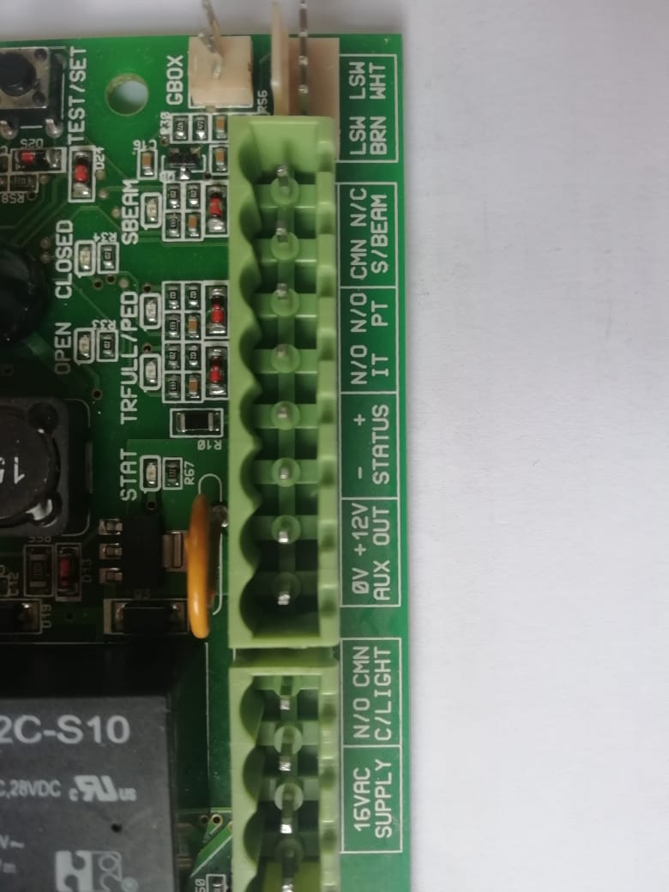
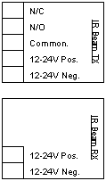
Infra red beam connections.
Note: If sentry beams are used, beam input must be connected to N/C on IR Beam RX.
CMN = Common

Slide 43
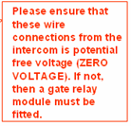
Intercom connections.
Intercom
DTS SL100 or SL150 PCB
IT = Intercom Trigger (Full open).
PT = Pedestrian Trigger.
CMN = Common.

Slide 44
Intercom connections with gate relay module.
Intercom
DTS SL100 AND SL150;PCB
Wires with 12V DC voltage output from intercom.
CM
AC/DC Input
N/C
N/O
Gate relay module
For full open trigger.
For pedestrian open trigger.
IT = Intercom Trigger (Full open).
PT = Pedestrian Trigger.
CMN = Common

Slide 45
External receiver connections.
N/C
N/O
Common.
Receiver
12-24V Pos.
12-24V Neg.
IT = Intercom Trigger (Full open).
PT = Pedestrian Trigger.
CMN = Common.

Slide 46
Auxiliary Status LED connections.
Pos.
LED.
Neg.
- LED ON when open limit is activated. (gate open).
- LED OFF when close limit is activated. (gate closed).
- LED flashing SLOW (1 sec. on/1 sec. off) (gate is in motion).
LED flashes 2 long/3 short continuously (gate is stopped midway).
LED flashes fast (250ms on/250ms off) continuously. (gate in overload).
LED flashes 3 fast flashes every 1.5 seconds. (battery low, <11/22VDC).
LED flashes 1 slow/2 fast continuously. (NO 220 VAC power present).

Slide 47
External courtesy light connections.
Use only 60 Watt globes,
maximum 100 Watt.
No flourescent or spot lights
should be used.
Energy savers are inclined to
flicker. (In this case, replace
with 60 Watt globes).
From PCB to light.
220 Volt Mains (Live) to PCB
220 Volt Mains (Neutral).
Lights will remain lit for a period of 3 minutes from time of trigger, the
time is not changeable. (Max. 2 lights)
If this function is not being used, the tamper alarm function can be used.

Slide 48
How does the tamper alarm work?
With the gate in the close position for 3 minutes, the alarm is armed.
The new version PCB’s (Manufacturing from 1/8/2011) will be armed immediately.
Should the gate be moved or forced away from its closed limit without a valid trigger, the system will sound the alarm.
Should the gate be moved or forced before 3 minutes (on the older version PCB’s), the system will still sound the alarm after 3 minutes from time of gate closure.
If activated as pulse, the relay will pulse immediately and every 3 minutes thereafter until the gate is moved back to the close limit or the alarm is disarmed by means of receiving a valid trigger. (New version PCB will only pulse once)
If activated as latch, the relay will close (Siren ON) for 3 minutes and open (Siren OFF) for 3 minutes continuously until the gate is moved back to the close limit or the alarm is disarmed by means of receiving a valid trigger.
The new version PCB also has a continuous latch alarm. (Use dipswitch 1 & 4) when programming this alarm function.
Should you wish to work on the gate without sounding the alarm - Open the override lever, give the PCB a valid trigger before opening the gate.
The PCB will give a beep as acknowledgement, disarmed.
With the alarm tamper activated, the Anti Hijack facility automatically comes into effect.

Slide 49
Anti Hijack facility (whether PULSE or LATCH)
How does the anti hijack facility works?
With the gate in the close position.
If the gate cannot open or move more than 150mm from a valid trigger, the system will sound the alarm.
If the infra red beams are tampered with (Showing as active), and the gate is triggered from a valid source, the gate will open but the system will immediately sound the alarm.
These alarms can be disarmed by receiving another valid trigger.

Slide 50
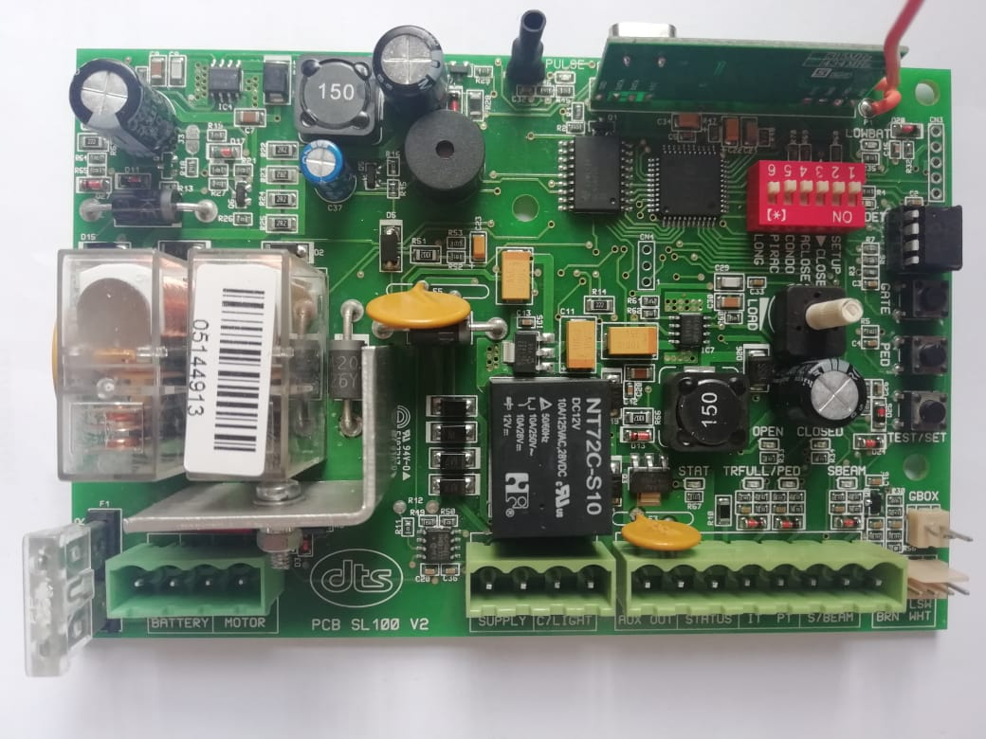
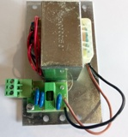
Fuses.
There is one 25Amp fuse on the SL100
And one 0.5 Amp fuse on the 16V AC Transformer
Replace fuses ONLY with equivalent value(Amp).
Never bridge the fuses

Slide 51
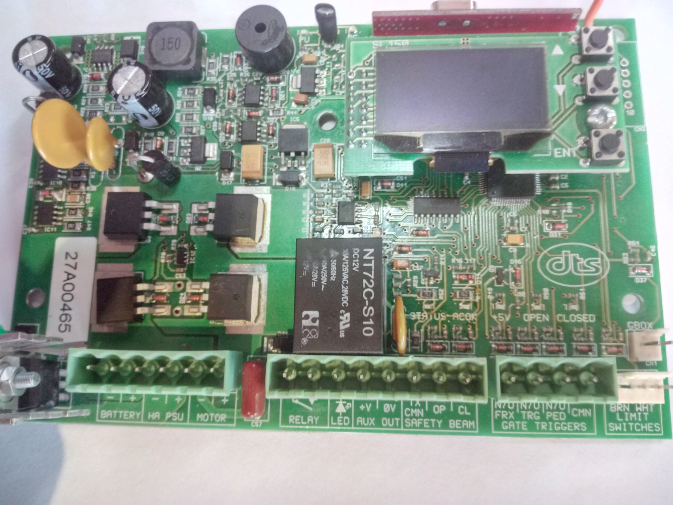
Programming (Calibrating)
Of the Elite 600 with SL150 PCB

Slide 52

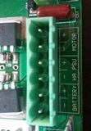
High access power supply unit – 220V at motor.
Connect 220V AC to LEN (Live/Earth/Neutral) connector on side of High access power supply unit
If the 220V AC power is cut off, the PCB will display ‘MAINS OFF’ on the screen and will work on battery power.
Black lead from power supply unit gets connected to – ( neg.) HA connection on PCB
Red lead from power supply unit gets connected to + ( pos.) PSU connection on PCB
DO NOT USE LOW VOLTAGE POWER SUPPLY (16V AC) ON THE
SL150 PCB
DO NOT CONNECT 220V DIRECTLY TO PCB

Slide 53
Programming
Run time (calibrating) setup (With total power up, AC and DC, on PCB)
Unlock and open the override lever on the gearbox.
Open the gate manually approximately 1 meter.
Close and lock the override lever on the gearbox.
Pull the gate in any direction until the gear locks in.
Note: 1. If gate opens first, motor direction is incorrectly selected.
2. Gate will automatically calibrate every time the power is restored after a total power failure.
3. The controller will drive the gate approximately 6mm past the closed limit activation position. Allowance must be made for this when setting the limit actuators.

Slide 54
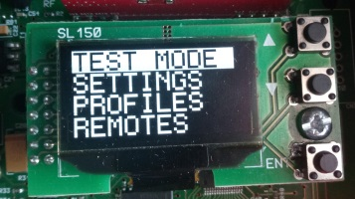
Programming (Calibrating)
Elite 600 PCB SL150
Please note following references
Up (up arrow)
Down (Down arrow)
Enter (ENT)

Slide 55
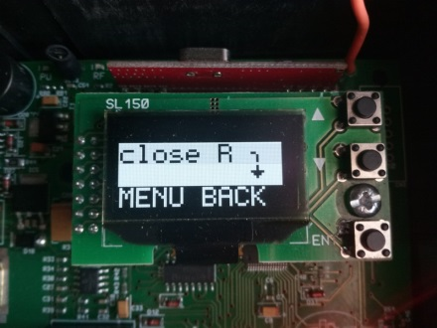
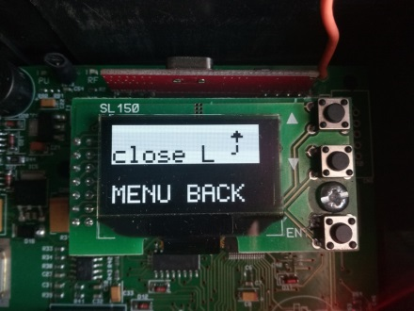
PCB SL150
1.On power up screen display will bring up Close L or Close R.
This must be changed to suit the site by pressing ENT on Close L.
When motor direction is correct scroll down to MENU BACK and press ENT to exit.
The screen will display the following: -
TEST MODE
SETTINGS
PROFILES
REMOTES
RUN STATUS
GEN STATUS.

Slide 56
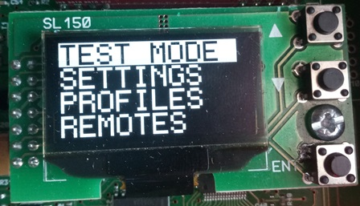


Programming (Calibrating)
(With Gate 1m open and override lever closed)
Press Enter on Test Mode
Press down to go to AUTOSET and press Enter
The gate must close in crawl speed until it reaches the close limit.
Will then open, still in crawl speed until it reaches the open limit.
Will then close normal speed.
Change to crawl speed towards the end until it reaches the close limit.
PCB will give 2 beeps as indication to confirm, program completed.
External connections (Beams, intercom, receiver ect) can now be connected.
Motor is now ready for use

Slide 57





Programming of the transmitters on Elite 600 PCB SL150
From main screen, press Enter.
Press down to go to REMOTES and press Enter
For full open trigger, press Enter on Learn Gate (LRN GATE)
Press and release the remote button you want to learn two times
about an arms length away from the PCB
The PCB will beep two times to confirm successful program, in addition
the screen will display under what location(LOC) the remote is saved
For PEDESTRIAN trigger, press down to go to LRN PED and press
Enter
Press and release the remote button you want to learn two times
about an arms length away from the PCB
The PCB will beep two times to confirm successful program

Slide 58
Programming of the transmitters on Elite 600 PCB SL150
LRN RELAY & LRN MASTER
Remote Programming using Master Remote
(Gate must be in the close position)
1.Press the master remote button, buzzer will emit a continuous beep for 5 seconds.
During that 5 seconds, press the new remote button. Continuous beep changes to rapid beeps for 5 seconds.
During that 5 seconds, press the same remote button again to validate the remote.
Successful programming will be acknowledged by 2 or 3 beeps.
If 3 x 100ms beeps are emitted on the pressing of the master remote, gate is not in the close position.
If 1 x 2 second beep emits on pressing the remote button, RX memory is full.
(Max. 500)
If 4 x 100ms beeps are emitted on pressing the remote button, remote is already in memory.
If new remote validation failed, rapid beeping will stop without the acknowledged 2 or 3 beeps being emitted.
Press Enter on LRN RELAY
Now press and release the remote button you want to learn two times about an arms length away
The PCB will beep two times to confirm successful programming
Lrn Relay (Will trigger the item connected to relay output on PCB)
Press Enter on LRN MASTER
Now press the remote button you want to learn two times about
An arms length away from PCB
The PCB will beep two time to confirm successful programming

Slide 59










Delete SINGLE or MULTIPILE Transmitters(TX)
From TEST MODE scroll Down to REMOTES and press Enter
Then press Down to go to DELETE and press Enter
Once you have pressed the Enter button.
Press the transmitter button that you want to delete.
The transmitter location will appear next to LOC=, EG LOC=1.
Press the Enter button and that remote will show as delete.
If the transmitter is not available but the number is known.
Scroll down to LOC= and press ENT button.
An arrow will appear next to LOC=.
Use the UP or Down buttons to select the required transmitter button.
Press the Enter button and scroll up to DELETE.
Press the Enter button, and that transmitter number will be indicated as deleted.
Press Enter on MENU BACK to exit.
To delete ALL transmitters, go to DELETE ALL and press Enter
Press Enter on YES
ALL transmitters will now be deleted

Slide 60



Programming of Pedestrian settings
The default opening is 1m and will auto close after 10 sec
Scroll down to PEDESTRIAN and press Enter
The screen will display the current settings on opening and auto close time
Press Enter on Sec= , you can set the time for auto close by pressing UP or Down and then pressing Enter
Scroll down and press Enter on Mtr= , to adjust the length of opening for pedestrian
Press UP or Down and then press Enter
When done remember to press Enter on MENU BACK

Slide 61







AUTO CLOSE
(Default, 10 seconds)
(infra-red beams must be fitted if auto close is activated)
Scroll down to settings and press ENT
- Scroll down to AUTO CLOSE and press ENT
- Select ON or OFF by using the ENT button
- If ON, scroll down to Sec=, press ENT button and an arrow will
appear net to the Sec=.
- By using the Up or Down buttons, select the time in seconds
required
- Min. 1 second to Max. 179 seconds
- Press ENT button on desired seconds
- Scroll down to MENU BACK and press ENT button twice to exit

Slide 62


CONDOMINIUM MODE
- Scroll down to SETTINGS and press ENT
- Scroll down to CONDO MODE and press ENT
- Now select ON or OFF by pressing the ENT button
- Note; if Condo is selected, IR CLOSE beams is the enabled
- Once selected, scroll down to MENU EXIT and press ENT to exit
Condominium/free exit loop.
When condominium/free exit loop is activated on the unit, the unit will not respond to any transmitter or manual push button while in its opening cycle or open position. When the gate is on the open limit the unit will automatically wait for the pre-programmed auto close time and then close. (Even if auto close function is not selected). When the gate is in its closing cycle and the transmitter or manual push button is pressed the gate will stop and open. Auto close cannot be overridden in condominium mode. (No party mode). If main power fails, the motor will still operate until battery reaches 9.5 volt. Gate will then remain open.
Change to manual by overriding the motor by the override lever. When the main power comes on again, lock in the override lever and the motor will function as normal.

Slide 63



PIRAC MODE
-From TEST MODE, scroll down to SETTINGS and press ENT
Scroll down to PIRAC MODE and press ENT
Now select ON or OFF by pressing the ENT button
Once selected, scroll down to MENU EXIT and press ENT to exit
P.I.R.A.C (Passive Infra Red Access Control)
With P.I.R.A.C mode activated, if the gate is in its opening cycle and the IR beam is triggered the gate will stop and close immediately after the IR beam is clear.
(This will happen even if auto close has not been selected).
(Be aware of this factor should a trailer be in tow!!!!)

Slide 64






Auxiliary Relay (Default, Gate light)
From TEST MODE, scroll down to SETTINGS and press ENT.
Scroll down until you get to AUX RELAY and press ENT.
By pressing ENT button, select REMOTE RELAY,
GATE LIGHT,
GATE FLASH
or ALARM MODE.
When on ALARM MODE you can press Enter on ALARM OFF to choose
Alarm OFF
The alarm facility connected to the PCB relay output will not be active.
Continuous
The alarm facility connected to the PCB relay output will give a continuous alarm/siren output when the alarm is triggered.
Timed mode
The alarm facility connected to the PCB relay output will give a 3 minute alarm/siren output when the alarm is triggered.
Pulse mode
The alarm facility connected to the PCB relay output will give a 1 second pulse alarm/siren output when the alarm is triggered.
The remote/transmitter that is programmed into the Remote Relay will now trigger the unit that is connected to the PCB relay output.
The lights that are connected to the PCB relay output will go on for 3 minutes once the gate has been triggered to open. The lights will remain ON for 3 minutes after the last trigger even if the gate has closed or go OFF after 3 minutes even if the gate is still open.
The same as GATE LIGHT will happen except that the light will FLASH instead of staying ON

Slide 65




From TEST MODE, scroll down to RUN STATUS and press Enter.
Screen will display:-
TR (Triggered by EG. transmitter.)
LS (Open or Close limit switch)
MAINS ON or OFF
BATT (Whatever the battery voltage is, (EG 13.5V)
Press Enter to exit.
From TEST MODE, scroll down to GEN STATUS and press Enter.
Screen will display:-
ER (Flashing Error number and Description of error)
OP (Number of Operations)
OL (Number of Overloads)
PU (Number of times unit was powered up)
Press Enter to exit.

Slide 66
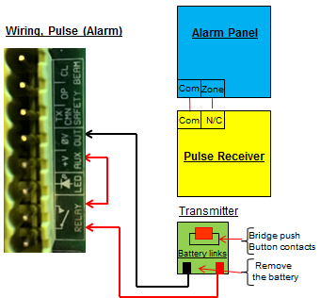
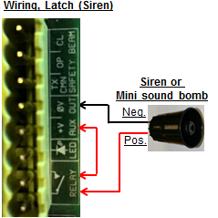
Tamper Alarm Facility.
1.The tamper alarm will automatically arm itself when the gate is in the closed position and will trigger
the alarm relay if the gate is moved or forced off the closed limit switch without a valid trigger.
2.If latch mode is configured, the relay will switch every 3 minutes until the alarm is restored.
3.If impulse mode is configured, the relay will trigger only once.
Any valid gate or pedestrian input trigger will cancel the tamper alarm which will automatically re-
arm once the gate is again in the close position.
The alarm can also be disabled for maintenance by opening the gearbox release and pressing the
remote control push button (confirmed by 3 short beeps). The alarm will remain disabled until the
gearbox release is closed and the gate closed position re-confirmed.
Anti-hijack/Alarm.
1. When the tamper alarm function is active and the gate receives a valid trigger but is
obstructed and cannot move or did not move more than 150mm, the alarm or siren will activate.
2.If the beams are obstructed or blocked when a trigger is received, the gate will open but will
then also sound the alarm.
3.If the gate should be forced or moved from the close limit in any way without receiving a valid trigger. The alarm will be activated.
Should the gate be tightened up in any manner and therefore on trigger cannot move or cannot move more than 150mm. The alarm will be activated.

Slide 67
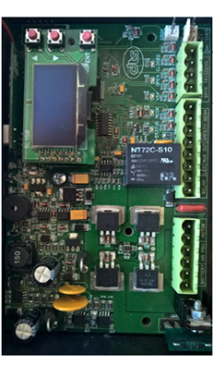
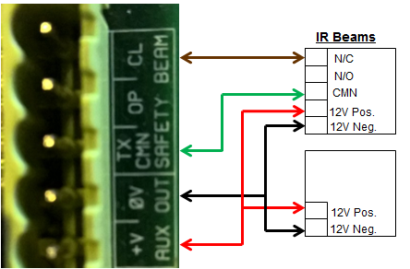
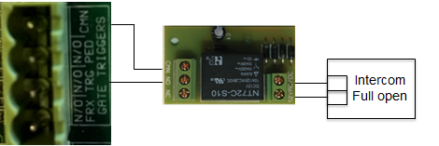
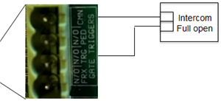
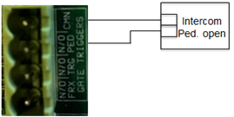
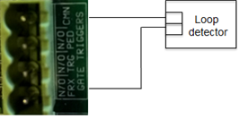
Diagrams for gate open triggers
NB – When connecting intercoms to the control card,
(TRG or PED) please ensure that your intercom
trigger output is potential free (ZERO voltage).
If not, a gate relay module must be fitted.
Note: - If no beams are connected, CL and TX CMN on the PCB by the Safety beams MUST be bridged.
DO NOT CONNECT 220V DIRECTLY TO PCB

Slide 68
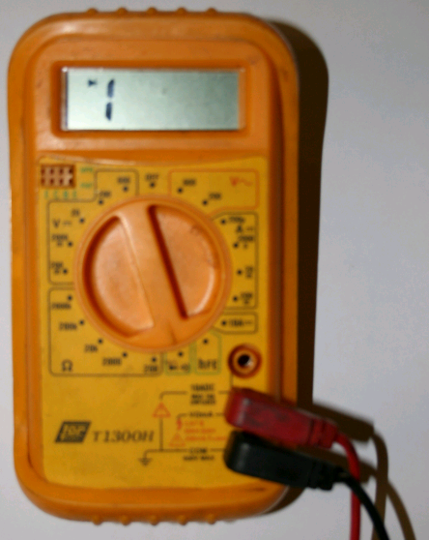
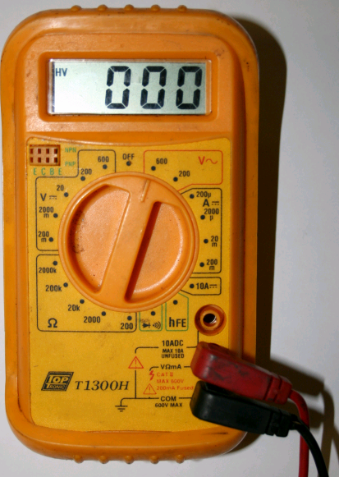
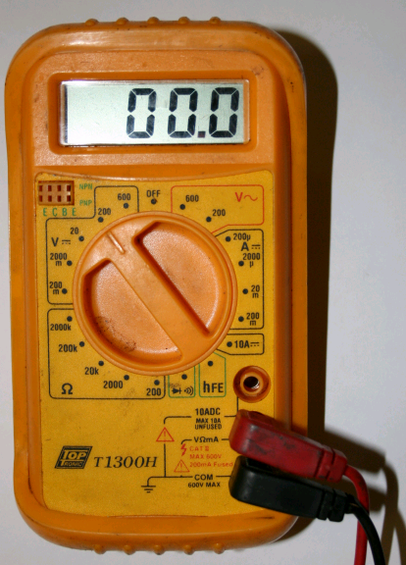

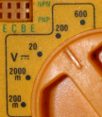

Use of multi-meter.
Setting multi-meter to check DC voltage.
HA PSU on PCB from transformer.
Battery voltage, with & without load.
Charge rate.
Auxiliary voltage.
Motor output voltage.
Setting multi-meter on continuity to check fuses.
-2 Amp AC fuse.
-500 Amp Auxiliary fuse.
-10 Amp 624 Motor/Load fuse.
-25 Amp 512 Motor/Load fuse.
-2 Amp H/A Transformer fuse.
(1.5 Amp for 624 motor)
Setting multi-meter to check AC voltage.
- 220Volt from mains.
- 16/24 VAC to PCB from transformer.

Slide 69
How to factory default the PCB.
Remove all power from the PCB, AC and DC.
Push and hold the TEST/SET button.
While holding the TEST/SET button, apply AC power to the PCB.
Once power has been applied, release the TEST/SET button.
PCB has now been set back to factory default.

Slide 70
Fault finding

Slide 71


Fault finding.
Check all fuses with a multi-meter, including the High access transformer fuse if no voltage is obtained from transformer.
Check incoming power source to transformer – 220 VAC at the:
- loose connector for Low voltage transformer
- and the green connector block at the bottom of the high access
transformer.
Check power to the PCB:
Low voltage transformer
SL100 = 16VAC
Check battery power without load – should be approximately 13.4 volt DC.
Check battery power with load - the voltage should not drop more than 1/3 volt.
Check the charge rate voltage – should be approximately 13.8 volt DC.
(Remember to disconnect the battery before measuring).
Check auxiliary output voltage – should be 12 volt DC.
220 VAC input
Neutral
Earth
Live
220 VAC
High Access transformer
SL150 = 25VDC

Slide 72



Disconnect all external connections (remove 8 connector block).
With the external connections disconnected, the motor now works indicates that the fault is within the externals.
Re-connect the externals one at a time until the fault re-occurs.
Ensure that all wiring is making good contact at the connector blocks.
By using a fish scale, check the pulling force in both directions.
Make sure that you have AC
and DC power on the PCB.
Check that the release/override door on the gearbox is close
That the double green wire is connected to the PCB.
Measure whether you have motor output power (12/24 VDC) on trigger.

Slide 73
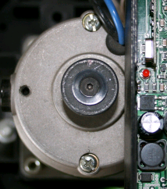

Turn magnet on top of motor.
Check if the red pulse LED goes on and off
when magnet is turned.
If not, check that the reader on the PCB is upright and as close as possible to the PCB cover.
Check both brushes on the motor (if shorter than 7mm, replace).
Also check that the brushes are wearing off evenly and are free of carbon.
Check the back of the PCB for any blown or burned tracks.
Look at the overall picture of the installation.
MOTOR
GATE
and the whole INSTALLATION.
Pulse LED

Slide 74
SL100 & SL150 List of audio indications and warnings.
  One continuous beep –
  One 1.5 second beep –
  One 2 second beep –
  One 2 second beep –
  One 3 second beep –
  One 3 second beep –
  Two 400ms beeps –
  Two 1 second beeps –
  Two 2 second beeps –
  Three 200ms beeps –
  Four 100ms beeps –
  Four 200ms beeps –
  Five 1 second beeps –
  Twenty 100ms beeps –
PCB is damaged, replace PCB.
“Party mode” has been activated.
Factory defaults have been set.
Beams are active, incorrectly wired or faulty when programming the motor.
or The run time was aborted for whatever reason.
Holiday lock out mode has been activated.
Gate triggered when motor is in 3 minute overload lock out.
Run time programming (calibrating) has been successful.
Pedestrian mode was triggered.
No AC power is present, running battery power only.
Battery power is too low, or
Override function is open or faulty.
Motor is in holiday lock out.
Check motor/load fuse (25amp).
Check motor brushes and armature.
PCB reader not picking up Magnet on motor.
Holiday lock out mode has been de-activated.
Motor has stalled or overloaded, then check the following points.
1) Gate pulling force (should not exceed SL100/12.5kg or SL150/15kg).
2) Load pot set to low (Turn pot completely clockwise).
3) Battery voltage under load (Check voltage drop or battery not connected).
4) Gearbox gearwheel.

Slide 75

End of training presentation
Thank you for attending.

Slide 76

Pretoria Branch

Slide 77
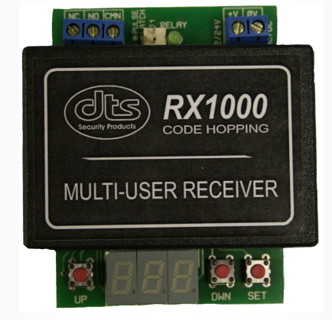


DTS Receivers
DTS RX1000
Multi user receiver.
Code hopping 434 mhz.
Can be used in FACTORY mode 1-1000 transmitters, or
Complex mode, 100 units, 10 transmitters per unit.
Can be connected as N/O or N/C.
Units can be blocked and unblocked without the transmitters.
Can copy over to another DTS RX1000.
DTS RX3
3 channel receiver.
Code hopping 434 mhz.
Can take up to 31 transmitters in combination between the 3 channels.
Can be connected as N/O or N/C individually on the 3 channels.
Can be used in PULSE or LATCH mode individually on the 3 channels.
Channel 3 can be used for a 5 minute time-out mode.
Can be changed from Open to Keelog mode and Visa Versa.
DTS RX1
Single channel receiver.
Code hopping 434 mhz.
Can take up to 31 transmitters.
Can be connected as N/O or N/C.
Can be used in PULSE or LATCH mode.
Can be changed from Open to Keelog mode and Visa Versa.
The DTS RX2 is now also available.
Accessories!!
DTS products normally used with Gate Motors.

Slide 78

DTS Loop Detector
Features
Pulse or Presence relay output.
4 Selectable exit times.
4 Selectable sensitivity ranges.
Audible beeper for setup purposes.
Status indication LED.
Normal or Security mode (Timed exit from intercom switch)
Selectable sensitivity boost for high ground clearance vehicles.
Loop condition monitoring (Open or short circuit).
Latching fault detect LED (Will indicate intermittent loop faults).
High / Low loop frequency selection.

Slide 79

DTS Universal Timer
Features
Level and Edge Triggering.
Retriggerable and Non Retriggerable.
Trigger N/O and N/C.
Debounce and Non Debounce.
Delay Mode.
Flip Flop Mode.
One Shot timer.

Slide 80

DTS Battery Load Tester
Features
Can test 12 or 24 volt gate/garage motor and or alarm batteries.
Protected against incorrect polarity connection.
Test batteries under 1 Amp load.

Slide 81

Gcom520
Features.
Stores up to 600 telephone numbers for access control.
Permanent or time limited user access. (ideal for Hotels and Guest houses)
Real time calendar clock.
Configuration parameters remotely set by SMS.
Supply voltage monitoring. (will SMS a warning message if low voltage)
Single monitored input for ON/OFF condition SMS alarming.
Programmable time delay for input monitoring.
Output relay operated from SMS commands or free missed calls.
User programmable alarm message. (message can be a SMS command to another Gcom500)
Status and remaining airtime reporting.
Compatible with all local GSM networks.
Very low power consumption. (less than 20mA in standby)
Operates from 12VDC power supply. (battery backup recommended)
Low voltage output relay rated at 1Amp.
IP50 housing.
ICASA approved.
Typical Application.
Access control system.
Industrial or domestic alarm control and monitoring.
Electric fence control and monitoring.
Refrigeration monitoring.
Remote pump control / water level monitoring.
Now available with Web interface – www.gcom500.co.za

