Slide 1
DTS Security Products

Slide 2
The DTS gate motors are designed and manufactured locally by DTS Security Products CC for South African conditions.
We continue to upgrade our products to meet the
consumers requirements.
Like the MULTI PC-Board with High Access and 16V AC transformer connections and solar ready function.

Slide 3
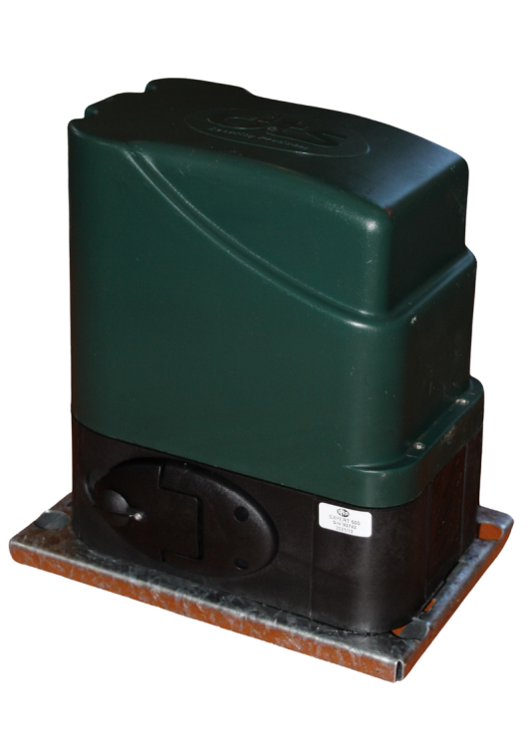
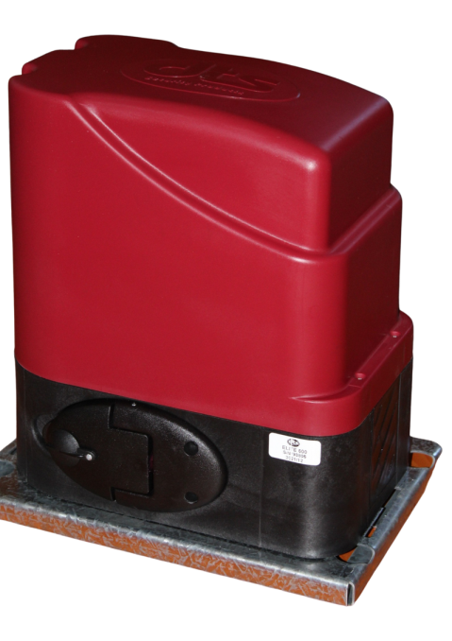
Gate motors
Expert 500 with Multi PCB
500 kg. (Gate weight)
12 volt motor.
Domestic use
Elite 600 with Multi PCB
600 kg. (Gate weight)
12 volt motor.
Complex / Business use
The gate pulling force is more important than gate weight.
DTS Expert 500 = 12.5kg continuous pulling force.
DTS Elite 600 = 15kg continuous pulling force.

Slide 4
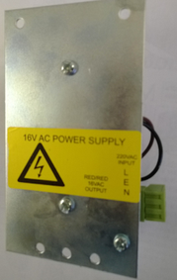
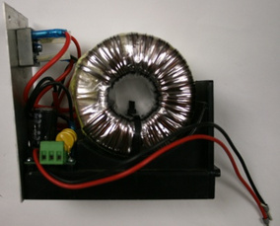
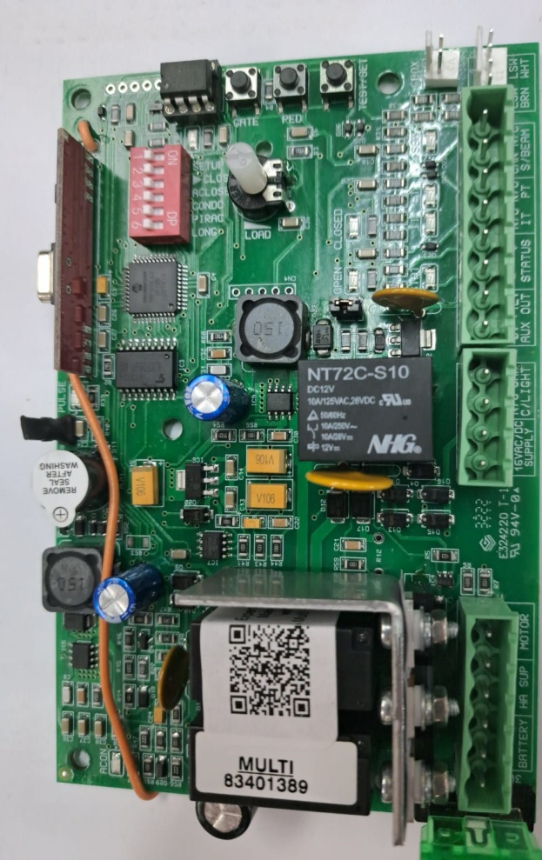
MULTI PCB
16V AC
High Access
Features
16V AC and High Access compatible connections
Available in Magnetic and Spring limits.
Auto close and Pedestrian functions
Onboard receiver up to 500 remotes combined between Full open and Pedestrian (DTS TX5 OCTO REMOTES ONLY)
Solar ready function for 50watt panel maximum directly onto PCB
Anti Hijack/Alarm function
Dynamic slowdown before stopping at opening and closing cycles
Holiday Lockout
Power saving mode (selectable)
Dip-switches
SETUP – To program/change features
Gate direction change – Off =close left, On =close right
Auto close function – Default 10 seconds(IR beams must be fitted)
Condominium – Complex use where gate will complete the 1st trigger and not stop when a second remote is pressed while in opening cycle(Auto -close is activated as well)
P.I.R.A.C – (Passive Infrared Access Control) Works with gate beams, gate will close after vehicle clears the beam (Be aware of this factor should a trailer be in tow!!!!)
Slowdown Distance
MULTI PCB

Slide 5
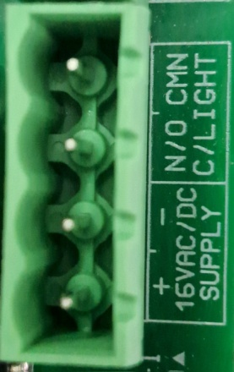
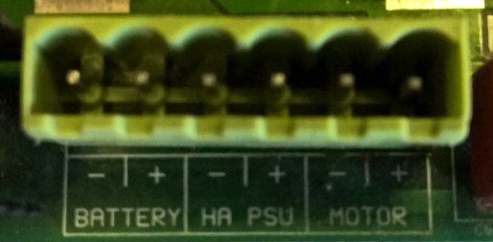
Power Connections
Low voltage 16V AC transformer
Connect 220V AC wires to input side of the Expert/16volt AC transformer (Live/Earth/Neutral) then connect the 2 output wires (red) to 16VAC connectors on controller card.
16V AC
High Access transformer
Black lead from power supply unit gets connected to – ( neg.) HA PSU connection on PCB.
Red lead from power supply unit gets connected to + ( pos.) HA PSU connection on PCB.
High Access

Slide 6
Solar to Motor
50Watt Solar Panel(50Watt max)
Expert 500
From 50watt Solar Panel connect directly to 16V AC
(Remove 16V AC transformer wires)
We suggest that you remove the transformer and add
an extra battery in the motor with the Solar Wiring Kit
NOTE: THIS WILL NOT VOID THE WARRANTY

Slide 7
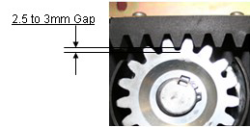
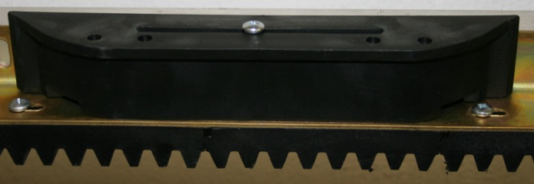
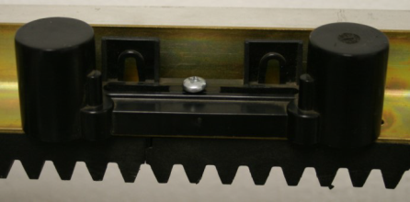
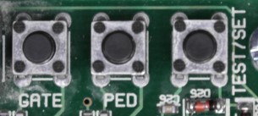
Open and Close Limit Programming
Before programming the limits make sure that the actuators/ “stoppers” is correctly placed on the gate and that the open and close light goes on 10 -15mm before gate is completely open or closed. Also check the load setting and Gate Direction with a 2.5 to 3mm gap between rack and pinion
Open gate 1m and close the gearbox release, push the gate to engage the gearbox and the press the TEST button once – The gate must then close first then open and then at normal speed close and give 2 beeps. (Note: The gate must never bump the close or open end stoppers.)
Changing Auto close time
With the gate in the closed position, switch dipswitch number 1 & 3 on > Now press and hold the TEST button and for every beep its 1 second > release TEST button desired time and switch 1 & 3 off and only number 3 back on Party mode > To override the auto close, wait till the gate reaches its open limit then press & hold the transmitter or manual push button for approximately 6 sec, then press remote again to continue as normal.
Programming Remotes
Full open > Press and release the GATE button and then press the desired remote button TWO times, the PCB will beep on completion (Note: Only DTS TX 5 OCTO Remotes will program)
Pedestrian open > Press and release the PED button then press the desired remote button TWO times, the PCB will beep on completion.
Erase one button > Press and hold the GATE button until PCB gives one beep then press remote button two times(Note: This applies for full open and Pedestrian remotes)
Master erase > Press and HOLD the GATE button, the PCB will beep once, Hold GATE button until PCB gives one long beep

Slide 8
Changing Pedestrian settings
Default: Gate will open for 1m and auto close after 10 seconds
With the gate in the close position > switch dipswitch number 1 & 4 on
Press and release the TEST button . The gate will start opening > press the TEST button again on the desired open distance
Now press and HOLD the TEST button and for every beep its 1 second > release TEST button on desired time and switch 1 & 4 off(Do NOT switch number 4 back on)
Changing Slowdown distance
Default: Dipswitch 6 on = 800mm / Dipswitch 6 off = 400mm
With gate in close position > switch dipswitch number 1 & 6 on
Press and HOLD the TEST button and for every beep its 100mm(1000mm maximum) > release TEST button desired distance and switch 1 & 6 off
Power saving mode(selectable by jumper)
If jumper is bridged over the two pins, that will disable the power saving mode.
When jumper is removed, power saving mode will be active.
Note: If an external receiver is fitted, the power for this receiver must be connected directly to the battery connection and not to the 12V auxiliary output The auxiliary power switches off when no AC (220V) or solar power is detected for 3 minutes. (Saving battery life). The PCB will rectify itself on a input trigger when in power saving mode.

Slide 9
Tamper Alarm function
Three minute Latching > Switch all dipswitches off ,remove AC and DC power and switch number 1 & 6 on, open the gearbox release. Reapply the Ac and DC then after 2 seconds switch number 1 & 6 off(The setting is confirmed by 1 – 5 beeps) and close the gearbox release then follow open and closing limit programming as normal
Impulse Tamper > Repeat above steps using dipswitch number 1 & 5
Continuous alarm output > Repeat above steps using dipswitch number 1 & 4
Anti-hijack > When the tamper alarm function is active and the gate receives a valid trigger but is obstructed and cannot move or did not move more than 150mm, the alarm or siren will activate.
How it works
The tamper alarm will automatically arm itself when the gate is in the closed position and will trigger the alarm relay if the gate is moved or forced off the closed limit switch without a valid trigger. If latching mode is configured, the relay will switch every 3 minutes until the alarm is restored. If impulse mode is configured, the relay will trigger only once. Any valid gate or pedestrian input trigger will cancel the tamper alarm which will automatically re-arm once the gate is again in the close position. The alarm can also be disabled for maintenance by opening the gearbox release and pressing the remote control push button (confirmed by 3 short beeps). The alarm will remain disabled until the gearbox release is closed and the gate closed position re-confirmed.

Slide 10
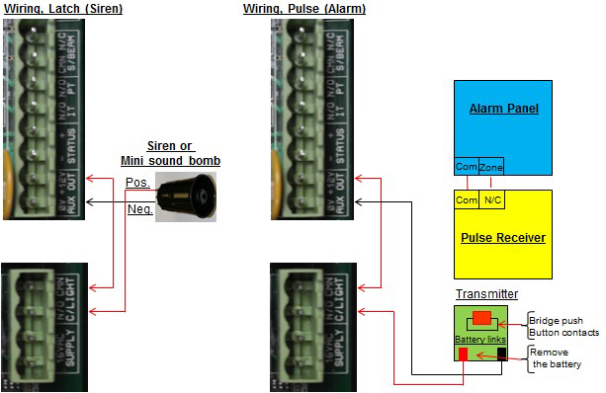
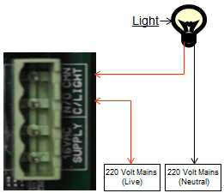
Wiring diagram Siren/Alarm & Courtesy light
Light will stay on for 3 minutes after a trigger is received
Please note that the Amps usage on the courtesy lights must not exceed 10Amps
Note: Either the courtesy light or Tamper alarm function can be used at a time, not both.
DO NOT CONNECT 220V DIRECTLY TO THE PCB

Slide 11
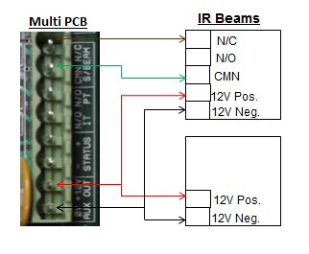
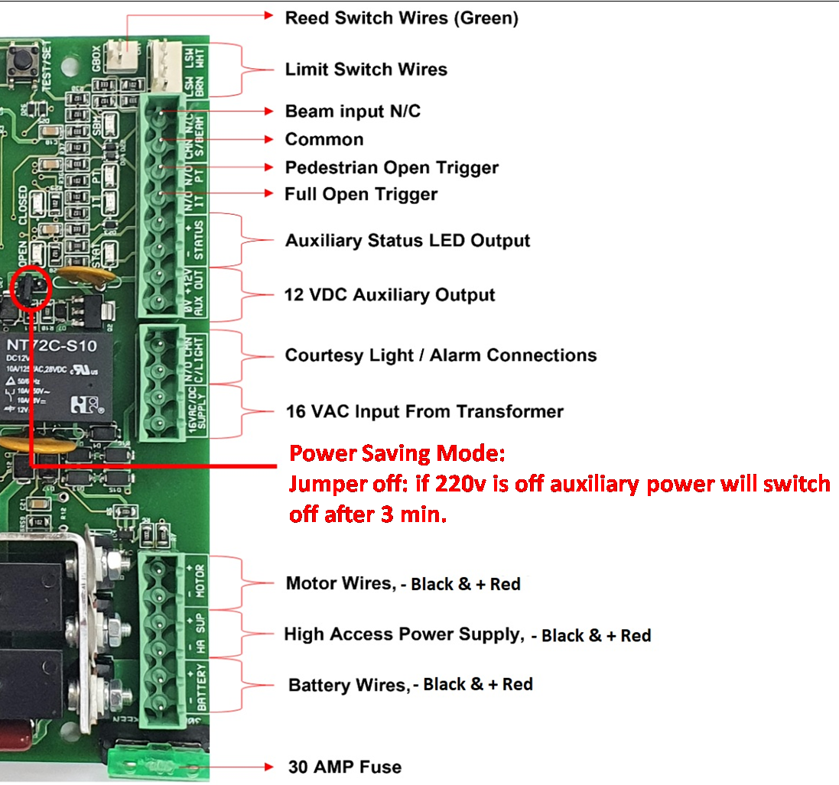
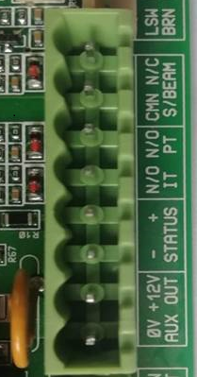
Wiring diagram Beams and External receiver
If no beams are fitted, NC and CMN must be bridged
Receiver
N/C
N/O
Common.
12-24V Pos.
12-24V Neg.
Note: If sentry beams are fitted, then S/BEAM, N/C on the PCB must be connected to N/O on the Beam

Slide 12
Fault Finding
List of audio indications and warnings.
One continuous beep - PCB is damage, replace PCB.
One 1.5 second beep - “Party mode” has been activated.
One 2 second beep - Factory defaults have been set.
One 2 second beep - Beams are incorrectly wired or faulty when programming the motor
(SBM light must be on) or runtime was aborted for whatever reason.
One 3 second beep - Holiday lockout mode has been activated.
One 3 second beep - Gate triggered when motor is in 3 minute overload lockout.
One 3 second beep - Check beam condition or no bridge between CMN & Beam N/C
Two 400 ms beeps - Run time programming (calibrating) has been successful.
Two 1 second beeps - Pedestrian mode was activated or No AC power is present, running on battery power only.
Three 200ms beeps - Battery power is too low, or Override function is open or faulty
Four 100ms beeps - Motor is in holiday lockout.
Four 200ms beeps - Check motor/load fuse (25amp).
- Check motor brushes and armature.
- PCB reader not picking up Magnet on motor.
Five 1 second beeps - Holiday lockout mode has been de-activated.
Twenty 100ms beeps - Motor has stalled or overloaded, then check the following points:
1) Gate pulling force (should not exceed Expert:12.5kg | Elite:15kg)
2) Load pot is set too low (Turn pot completely clockwise)
3) Battery voltage under load (12volt) (Not connected)
4) Gearbox gearwheel.

Slide 13
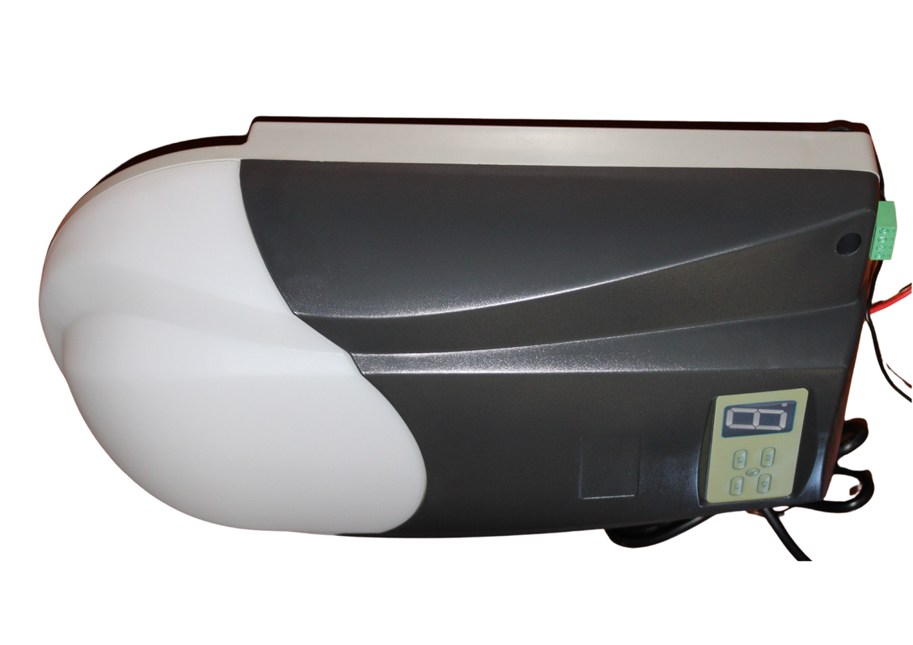
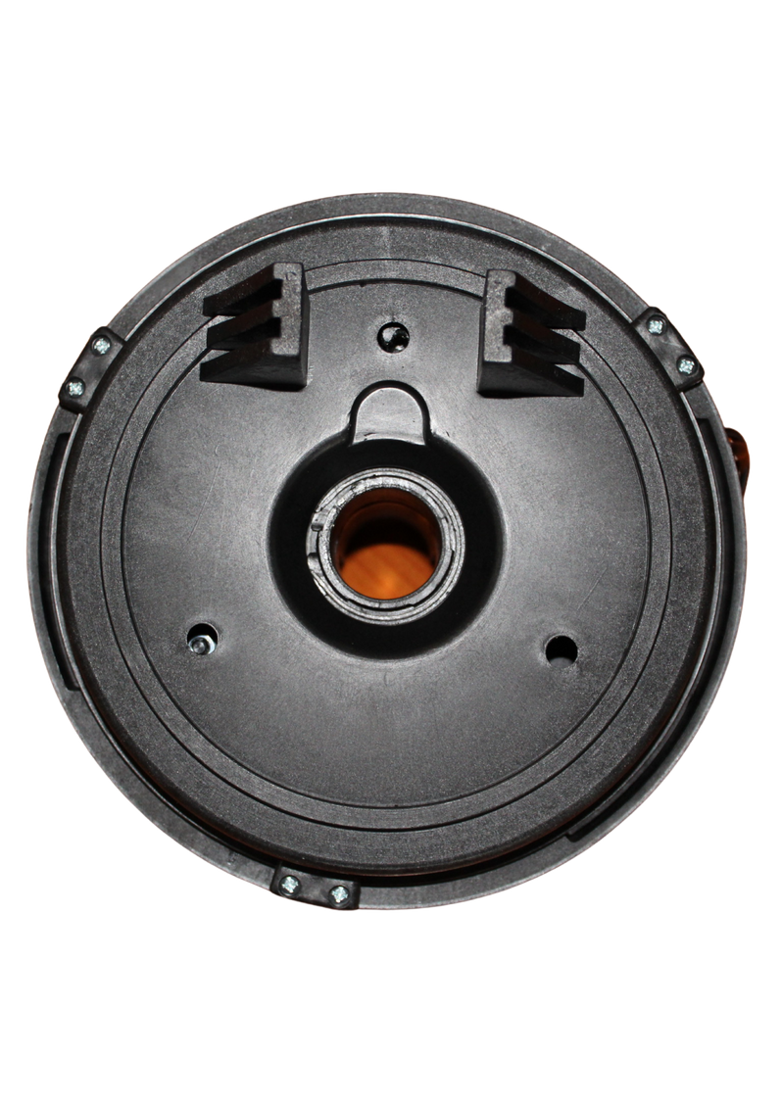
Garage Door Operators (GDO)
DTS 1000/ 1000 HS & 12 RE

Slide 14
The DTS Garage door openers are imported by
DTS Security Products CC .
We continue to upgrade our products via our suppliers
to meet the consumers requirements.

Slide 15
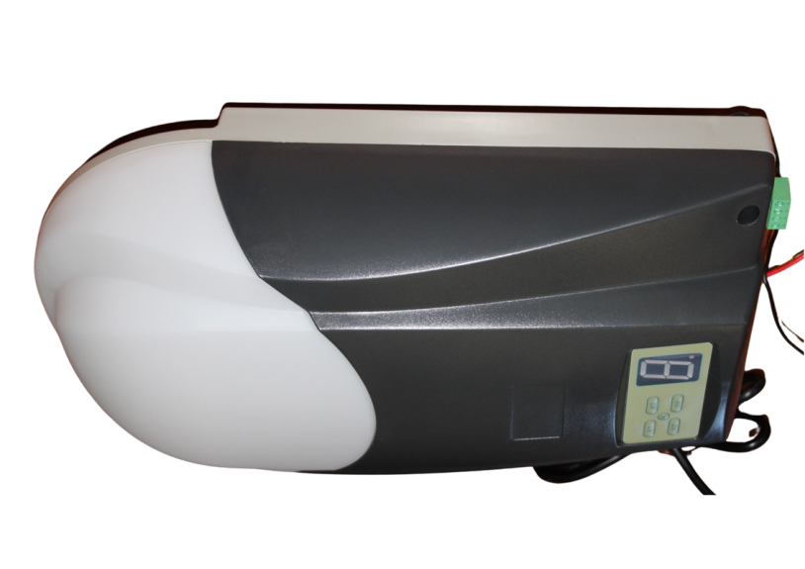
DTS 1000 & 1000 HS
For Sectional and Tip up garage doors.
Features
24 volt battery back up.
24 volt DC motor design.
Anti crush mechanism.
On board rolling code receiver (RX).
Maximum of 20 remotes.
Auto close facility.
Manual override release facility.
Easy to install.
Simple programming.
Safety Infra Red Beams and External Receiver can be connected.
Full spares and service back-up.
Value for money.

Slide 16
Quick Programming DTS1000
Quick Setting of Open and Close Positions.
1) Press and hold SET (K1) until the LED displays number 1. It turns into opening learn state.
2) Now press and hold UP (K3), the door will travel to the open position, release the button when
the door has reached the desired open position.
3) If the door has overrun its open position, press the DOWN (K4) button to move the door
downwards. Adjust and fine tune the open position by pressing UP (K3) and DOWN (K4).
4) Press SET (K1) to store the open position, the LED will display number 2, it is now ready to set
the close position.
5) Press and hold DOWN (K4), the door will travel to the close position, release the button when the
door has reached the desired close position.
6) If the door has overrun its close position press the UP (K3) button to move the door upwards.
Adjust and fine tune the close position by pressing DOWN (K4) and UP (K3).
7) Press SET (K1) to store the close position. The door will then open and close automatically to
map the open and close sensitivity force requirements.(Program the load setting by holding K1
until number 3 appears, with K3 increase load, 9 maximum . Press and release K1 to store load.)
8) The door is now set for normal operational mode.
Note: Should the door overload after the programming is completed, please manually reset the load by:
Press and hold SET (K1) until the LED displays number 3, release SET (K1), the force setting number will appear from 1 – 9. It is now in force adjustment mode.
Press UP (K3) to increase the force by one and DOWN (K4) to decrease the force by one. Maximum is 9 and the minimum is 1. (Suggestion would be to set load to 8)
Press SET (K1) to store your setting.

Slide 17
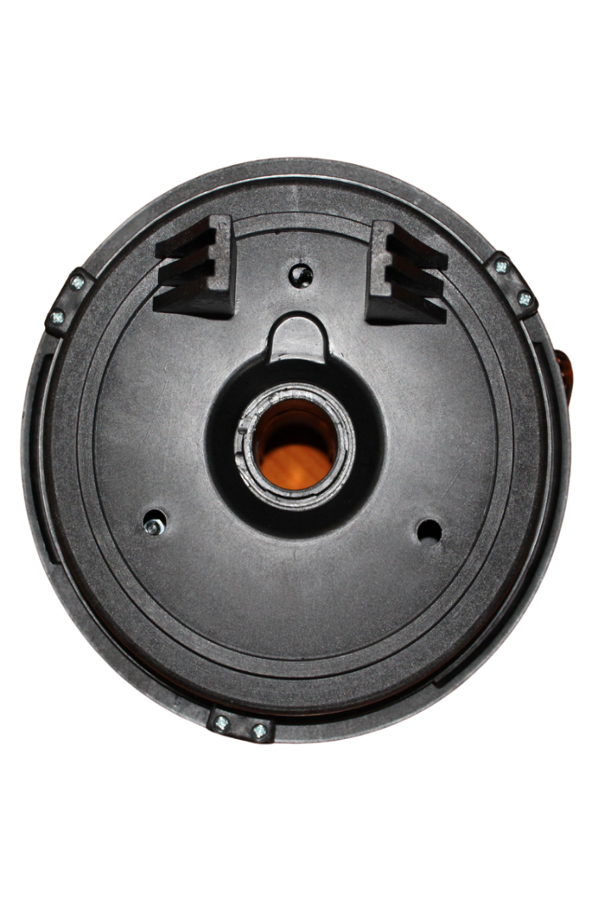
DTS 12RE
For single roll up garage doors.
Features
Optional 24 volt battery back up.
24 volt DC motor design.
Anti crush mechanism.
On board rolling code receiver (RX).
Maximum of 20 remotes.
Auto close facility.
Manual override release facility.
Easy to install.
Works with most roller doors.
Operates smooth and quietly.
Safety Infra Red Beams and Eternal Receiver can be connected.
Full spares and service back-up.
Value for money.

Slide 18
Quick Programming
Quick Setting of Open and Close Positions.
1) To change installation side Press and hold SET until the LED displays number 5. Default is 0 for
right hand side and number 1 is for left hand side installation. Change by pressing UP and DOWN
and press SET to store
2) Press and hold SET until the LED displays number 1. It turns into opening learn state.
3) Now press and hold UP, the door will travel to the open position, release the button when
the door has reached the desired open position.
4) If the door has overrun its open position, press the DOWN button to move the door
downwards. Adjust and fine tune the open position by pressing UP and DOWN
5) Press SET to store the open position, the LED will display number 2, it is now ready to set
the close position.
6) Press and hold DOWN, the door will travel to the close position, release the button when the
door has reached the desired close position.
7) If the door has overrun its close position press the UP button to move the door upwards.
Adjust and fine tune the close position by pressing DOWN and UP
8) Press SET to store the close position. The door will then open and close automatically to
map the open and close sensitivity force requirements.(Program the load setting by holding SET
until number 3 appears, with UP increase load, 9 maximum. Press and release SET to store load.)
9) The door is now set for normal operational mode.
Note: Should the door overload after the programming is completed, please manually reset the load by:
Press and hold SET until the LED displays number 3, release SET, the force setting number will appear from
1 – 9. It is now in force adjustment mode.
Press UP to increase the force by one and DOWN to decrease the force by one. Maximum is 9 and the minimum
is 1. (Suggestion would be to set load to 8)
Press SET to store your setting.

Slide 19
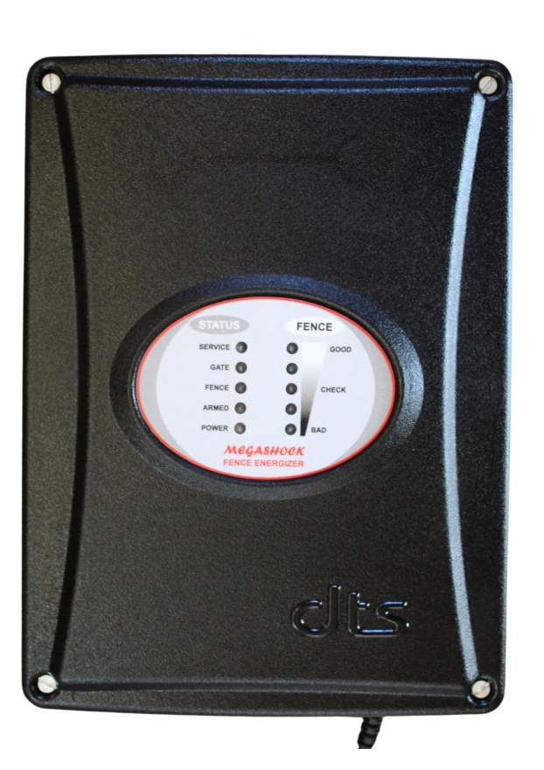
DTS Megashock 5 Energizer

Slide 20
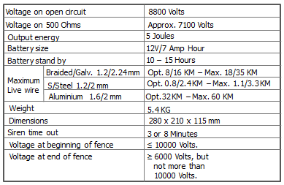
DTS Megashock 5 Energizer
Features
True 5 Joule output
Tamper Alarm feature
Onboard fence trouble shooting
Build in surge protection
Secure remote arming and disarming
Built in battery backup
Full spares and service backup
Onboard receiver arm/disarm and panic

Slide 21
DTS Megashock 5 Energizer
Wire connection for Monitored Earth
Wire connection for Non Monitored Earth
Dipswitch Selection
Dipswitch 1 - ON, Override tamper alarm switch.
Dipswitch 1 - OFF, Normal run mode.
Dipswitch 2 - ON, Strobe light will stay on when energizer is armed.
Dipswitch 2 - OFF, Strobe light on alarm will stay on until manually reset.
Dipswitch 3 - ON, Siren will on alarm go on & off for 3 or 8 minutes until manually reset.
Dipswitch 3 - OFF, Siren will on alarm go off for 3 or 8 minutes, then reset itself if alarm condition is cleared.
Dipswitch 4 - ON, Gate alarm delay = 3 minutes.
Dipswitch 4 - OFF, Gate alarm delay = 1 minute.
Dipswitch 5 - ON, Fence alarm sensitivity = 2 consecutive error cycles.
Dipswitch 5 - OFF, Fence alarm sensitivity = 3 consecutive error cycles.
Dipswitch 6 - ON, Alarm timer = 8 minutes.
Dipswitch 6 - OFF, Alarm timer = 3 minutes

Slide 22
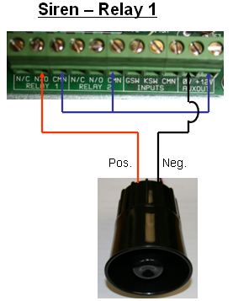
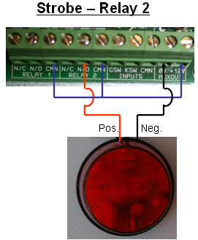
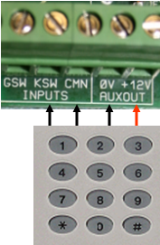
External Connections
Receiver/Keypad/ Switch
Programming remotes
For Arm and Disarm press and release the ARM button then press your remote two times
For Panic/Siren press and release the SIREN button then press your remote two times
Note: External connections via Receiver, Keypad and Switch must be used in LATCH mode

Slide 23
Fault finding
Switch off the unit and remove the live and earth wires from the unit.
Bridge live out to live return on the unit.
Bridge earth out to earth return on the unit and switch the unit back on(Remember to
switch dipswitch number 1 on while testing with the cover off)
If the unit still gives an immediate alarm, check all fuses, connections and consult
supplier
If not, switch the unit off again, connect only the earth wires back onto the unit and
switch the unit back on.
If the unit now gives an alarm, the unit is insufficiently earthed, add more earth spikes,
or there is a communication break on the earth line.
If not, the live wire has a fault on the line, search for the fault and repair before
connecting the live wires back onto the unit.
If the 3.15 fuse is blown, the energizer will not work of the battery. (Reversed polarities
will blow the fuse)

Slide 24
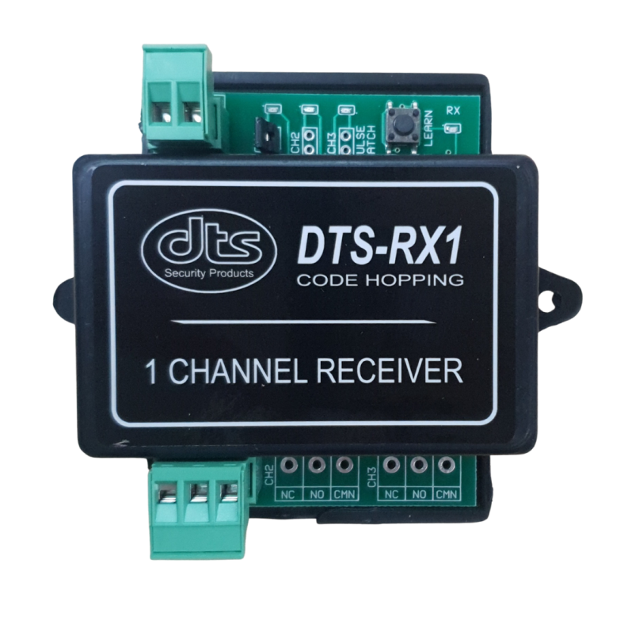
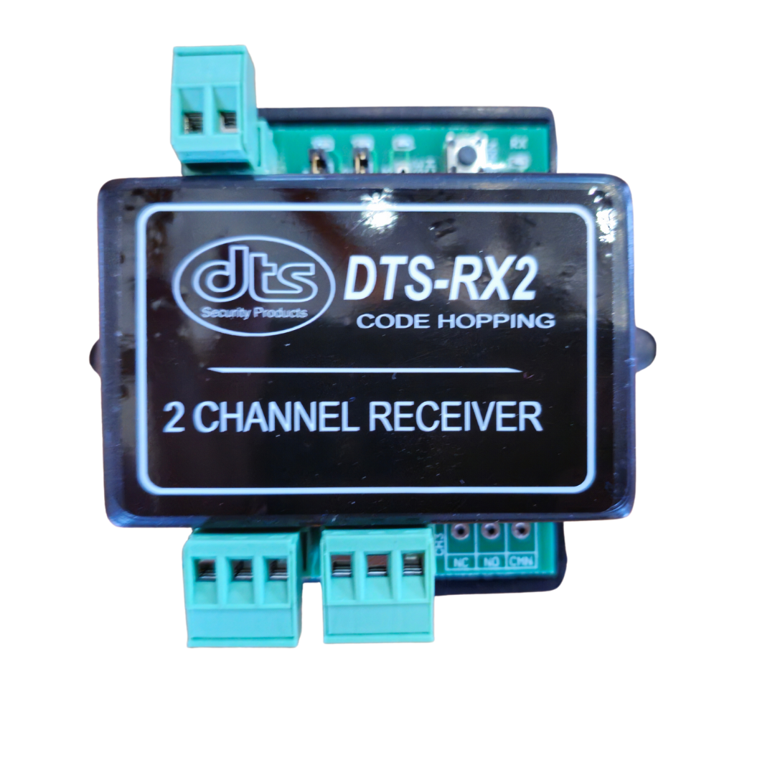
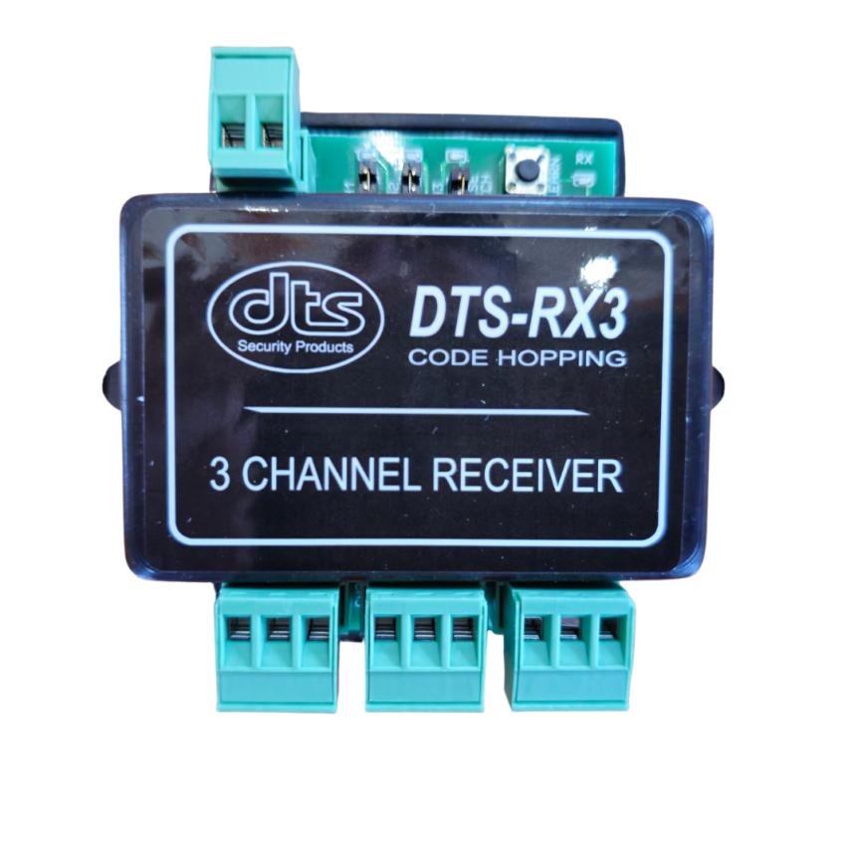
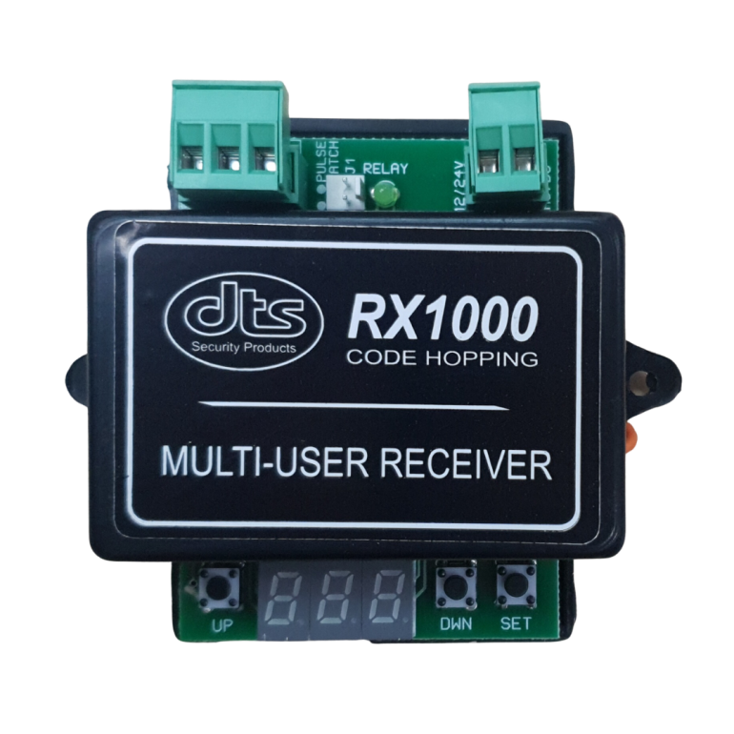
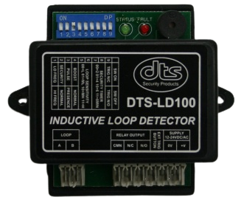
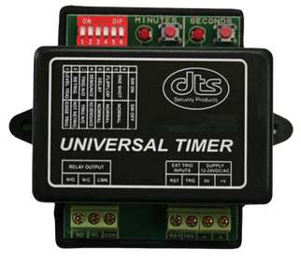
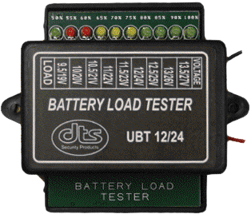
Accessories
Gcom520
DTS RX100
DTS RX200
DTS RX300
DTS RX1000
DTS Loop Detector
DTS Universal Timer
Battery Load Tester

Slide 25
Receivers
RX100(220V Relay with build in timer)
RX200(220V Relay with build in timer)
RX300(220V Relay with build in timer)
DTS RX1000 (1000 user Complex)

Slide 26
Quick features on Receivers
“Open receiver” – Most 434Mhz code hopping remotes will be able to work.
Option between Latch or Pulse.
Rx 100,200 & 300 can take 31 remotes.
With a range (depending on interference and line of sight) of 50 -80M, NOTE: Not described as long-range receiver.
Easy to program & connect.
RX100,200 & 300 with build in relay timer, programmable up to 60min
220V Relay – can switch lights

Slide 27
DTS Loop Detector
Features
Pulse or Presence relay output.
4 Selectable exit times.
4 Selectable sensitivity ranges.
Audible beeper for setup purposes.
Status indication LED.
Normal or Security mode (timed exit from intercom switch).
Selectable sensitivity boost for high ground clearance vehicles.
Loop condition monitoring (open or short circuit).
Latching fault detect LED (will indicate intermittent loop faults).
High / low loop frequency selection.

Slide 28
DTS Universal Timer
Features
Level and Edge Triggering.
Retrigger able and Non Retrigger able.
Trigger N/O and N/C.
Debounce and Non Debounce.
Delay Mode.
Flip Flop Mode.
One Shot timer.
DTS Battery Load Tester
Features.
Can test 12 or 24 volt gate/garage motor and alarm batteries.
Protected against incorrect polarity connection.
Test batteries under 1 Amp load.

Slide 29
Gcom520
Features
Stores up to 600 telephone numbers for access control.
Permanent or time limited user access (ideal for Hotels and Guest houses).
Real time calendar clock.
Configuration parameters remotely set by SMS.
Supply voltage monitoring (will SMS a warning message if low voltage).
Single monitored input for ON/OFF condition SMS alarming.
Programmable time delay for input monitoring.
Output relay operated from SMS commands or free missed calls.
User programmable alarm message (message can be a SMS command to another Gcom500).
Status and remaining airtime reporting.
Compatible with all local GSM networks.
Very low power consumption (less than 20mA in standby).
Operates from 12VDC power supply (battery backup recommended).
Low voltage output relay rated at 1Amp.
IP50 housing.
ICASA approved.
Typical Application.
Access control system.
Industrial or domestic alarm control and monitoring.
Electric fence control and monitoring.
Refrigeration monitoring.
Remote pump control / water level monitoring.
With Web interface www.gcom500.co.za

